Slide 1


Gender in Rural Institutions and Governance: A Review of Existing Tools
Hagar ElDidi*, Katrina Kosec*, and Ruth Meinzen-Dick*
October 14, 2021
*International Food Policy Research Institute

Slide 2
Introduction
Institutions and governance profoundly affect women’s status in the household, community, and society, in addition to affecting rural poverty, hunger, and malnutrition.
  Variety of tools to analyze and address the intersection of gender with institutions and governance.
Formal and informal arrangements/organizations.
Both are sources of power and are shaped by the distributions of power within society.
  Interaction with gender, as an important source of social and power differences, is therefore particularly relevant.
  Gender, as a socially constructed characteristics of men and women, boys and girls, is itself a fundamental social institution.
Two important strands of research.
  How does gender shape institutions and governance, and how can one bring about gender responsive governance?
  Do institutions and governance differentially benefit women and men?

Slide 3
Four main questions
How frequently do tools analyze each of the two main strands of research identified above?
What methods are employed by tools considering various levels, sectors, and foci?
What types of tools consider various levels, sectors, and foci?
Consider the role of intersectionality in the tools — to what extent do they permit analysis of only gender, versus gender and some other personal or group characteristic?

Slide 4
Purpose
Help researchers, practitioners, and policymakers interested in either broad strand of research to identify tools to use.
Help those who develop tools identify gaps in existing sets for which new development may be useful.
Focus on the interaction between gender and other institutions, including the governance environment.
  Gendered access to key outcomes such as tenure security, public sector services, and participation in and influence over organizations governing livelihood opportunities.
Focus is on tools that are applicable to research and practice related to rural development or agri-food systems
  Predominately in a developing country context

Slide 5
Methods: screening process
69 tools identified.
Scope of tools:
  Documents presenting a methodology, guidance, or set of questions for either measuring or promoting women’s empowerment and good governance more broadly.
  Omits papers and knowledge products whose primary purpose is to disseminate evidence.
  Wide range of secotrs and themes relevant to food systems and or governance in rural areas
Outreach to experts working on governance and institutions, and/or gender issues
  Snowballing approach.
Internet searches using four key words and phrases:
  Tools
  governance or institutions
  rural or agriculture
  gender or women
Formal publications and grey literature.
Extensive list; but not exhaustive.

Slide 6
Methods: tool classification
Strand of research
  A) how does gender shape institutions and governance, and how can one bring about gender responsive governance? and B) do institutions and governance differentially benefit women and men?
Methods
  Quantitative; Qualitative; Mixed
Types
  Framework; Data collection; Implementation guidance; Participatory implementation guidance; Monitoring and Evaluation (M&E); Toolkit
Gender focus
  Primary; Secondary ; Gender not considered
Intersectionality
  Age; Education; Ethnicity; Socio-economic status
Level/ scale of governance and institutions
  Household; Community; Group; National; Sub-national;…
Sector/ theme
  NRM; Political engagement; WASH; Social networks; Agriculture and markets; ...
Foci
  Access to resources; Collective action; Equity; Leadership; Participation in groups; Political participation; Rights/tenure;…

Slide 7

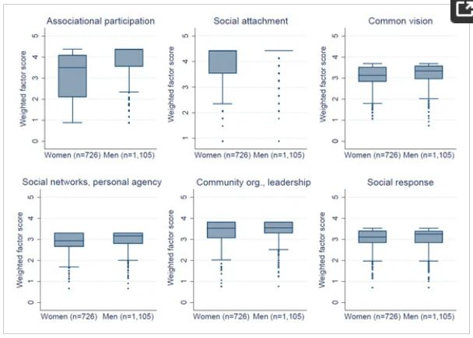
Sample tools
Source: Sarmiento Barletti et al. 2020
Title | Objective | Type
How are we doing? | Enable participatory reflective monitoring and assess effective participation in multi-stakeholder forums (MSFs) for natural resource governance. | Participatory implantation guide; M&E
General Collective Efficacy Scale | A 26-item measure of collective efficacy mechanisms (social response; social networks and personal agency; social attachment; common vision; associational participation; and community organization and leadership). | Data collection
Women's Voices in Open, Inclusive Communities and Effective Spaces (VOICES) | Measures of social cohesion and collective efficacy, and structural and cognitive social capital (types of groups in which women participate; reasons why women do or do not attend/participate in community meetings; women's awareness of their legal rights;…). | Data collection
Forest tenure pathways to gender equality: A practitioner´s guide | Proposes diagnostic analysis to create an empirical foundation for change that support the design and implementation of gender-responsive forest tenure reform at various scales. Multi-level, (policy, national, subnational, community level) | Implementation guide
Source: Delea et al. 2018

Slide 8
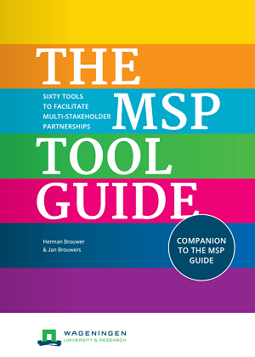
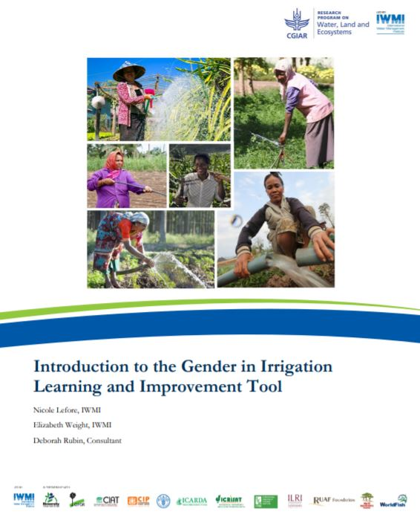
Sample tools
Source: Brouwer and Brouwers 2017
Title | Objective | Type
The Multi-stakeholder Platform (MSP) Guide | Covers the rationale behind holding MSPs, what principles are essential to consider, and an explanation of the key components in designing and facilitating a successful MSP. Provides 60 participatory tools for analysis, planning and decision making. | Toolkit; Participatory implementation guide
Gender in climate change, agriculture, and natural resource policies: insights from East Africa | Rating the extent of gender mainstreaming in national and subnational climate, agriculture and natural resources policies. | Implementation guide
GILIT: Gender in Irrigation Learning and Improvement Tool | A series of indicators with supporting discussion questions and an adaptable scoring system. It identifies areas of policy and operations in formal irrigation schemes or project that have been successful or need adjustment to promote gender equity. | Implementation guide; Data collection
Women’s Land Tenure Security: A Conceptual Framework | Develops a conceptual framework around women’s land tenure security and the factors that influence it. | Framework
Source: Lefore et al. 2017

Slide 9
Results: categories

Slide 10
Results: categories

Slide 11
Results: categories

Slide 12
Results: cross-tabs
Strand of research* - Method | Mixed | Qualitative | Quantitative
A | 25 | 19 | 18
B | 16 | 11 | 7
Sector - Method | Mixed | Qualitative | Quantitative
Agriculture and markets | 6 | 5 | 0
Climate change | 1 | 1 | 0
Laws and regulations | 3 | 3 | 0
MSPs | 4 | 2 | 0
NRM | 14 | 13 | 1
Nutrition | 0 | 1 | 0
Payment for Environmental Services | 2 | 0 | 0
Political engagement | 5 | 1 | 14
Social networks | 4 | 1 | 7
WASH | 1 | 0 | 1
Focus - Method | Mixed | Qualitative | Quantitative
Access to resources | 5 | 5 | 1
Access to services | 1 | 1 | 3
Agency | 1 | 0 | 6
Collective action | 4 | 2 | 4
Equity | 4 | 7 | 0
Inclusion | 6 | 7 | 0
Leadership | 6 | 0 | 8
Participation in groups | 19 | 10 | 11
Policy assessment/ reform | 5 | 5 | 1
Political participation | 6 | 2 | 13
Project self-assessment | 6 | 4 | 0
Rights/tenure | 6 | 5 | 0
Method - Intersectionality | Age | Education | Ethnicity | No | Socio-economic status
Mixed | 11 | 7 | 16 | 9 | 10
Qualitative | 9 | 6 | 14 | 5 | 8
Quantitative | 8 | 8 | 8 | 12 | 5

Slide 13
Results: cross-tabs
Type - Intersecitonality | Age | Education | Ethnicity | No | Socio-economic status
Data collection | 12 | 11 | 14 | 16 | 8
Framework | 5 | 5 | 8 | 2 | 4
Implementation guide | 11 | 7 | 17 | 5 | 12
M&E | 7 | 3 | 9 | 1 | 4
Participatory implementation guide | 3 | 2 | 6 | 5 | 3
Toolkit | 1 | 1 | 2 | 2 | 1
Type - Level | All levels of government | Community | Community organizations | Household | National | Stakeholder group | Sub-national
Data collection | 4 | 20 | 3 | 5 | 7 | 2 | 7
Framework | 2 | 8 | 0 | 1 | 3 | 0 | 4
Implementation guide | 2 | 18 | 1 | 0 | 4 | 3 | 6
M&E | 0 | 10 | 0 | 0 | 2 | 2 | 3
Participatory implementation guide | 1 | 11 | 0 | 0 | 3 | 3 | 4
Toolkit | 1 | 3 | 0 | 0 | 1 | 2 | 2
Type - Sector | Agriculture and markets | Climate change | Laws and regulations | MSPs | NRM | Nutrition | Payment for Environmental Services | Political engagement | Social networks | WASH
Data collection | 3 | 0 | 1 | 1 | 6 | 0 | 1 | 18 | 9 | 2
Framework | 3 | 1 | 2 | 1 | 7 | 1 | 0 | 1 | 0 | 0
Implementation guide | 3 | 2 | 1 | 3 | 18 | 0 | 2 | 1 | 2 | 0
M&E | 2 | 0 | 0 | 0 | 7 | 1 | 0 | 0 | 1 | 1
Participatory implementation guide | 2 | 0 | 2 | 3 | 5 | 0 | 0 | 1 | 2 | 1
Toolkit | 1 | 0 | 1 | 3 | 2 | 0 | 0 | 0 | 1 | 0

Slide 14
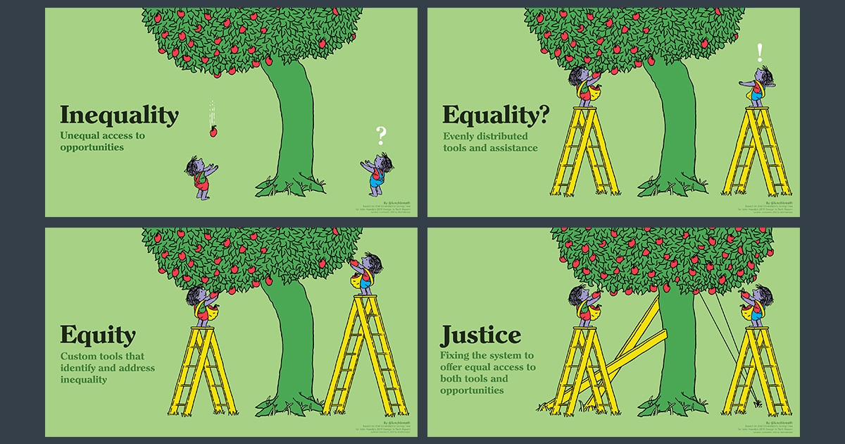
Discussion
Results reflect the diversity of gender-related tools at the nexus of gender and governance and institutions.
Considerably more tools encompass strand of research A (how does gender shape institutions and governance, and how can gender responsive governance be achieved?) compared to strand of research B (do institutions and governance differentially benefit men and women?).
  Suggests that more tools consider the process of gender incorporation rather than measure the outcomes of certain institutions or governance arrangements for women (and men).
  Link to the notion of justice (Baxter 2004; Österblom et al. 2020):
    (A) accords with the notion of “procedural justice,” or the recognition of rights and needs of all groups and the level of inclusion and participation in decision-making
    (B) accords with the notion of “distributive justice,” referring to fairness in the sharing of benefits and the minimization of harms across groups
  Both notions of justice are addressed in existing suite of tools, but more tools in the B category may be needed.
Source: greateducation.org

Slide 15
Discussion
Almost a third of the tools attributed to more than one sector; applicable in more than one context.
  Governance as a concept assumes a multiplicity in dimensions including actors, levels of governance and sectors (Bressers et al. 2016).
  In line with Lynam et al.’s (2007) review of participatory tools related to community NRM, where they find that many of the tools are flexible and adaptable to wider contexts.
The focus on women’s land tenure and property rights gaining deserved attention and prominence (Scalise and Giovarelli 2020).
  A growing recognition that tenure security plays an important role in women’s empowerment and livelihoods.
The process of applying the tool is critical in determining the extent of success of the tool (Lynam et al. 2007).
  Attitudes and skills of the researchers or practitioners who use the tool are crucial, especially with participatory tools.

Slide 16
Way forward
Tracking trends of methods, approaches and tool types over time for future research.
  Reflect on types of tools that have been gaining traction for various sub-themes under governance and institutions, and better identify tool gaps.
Analyzing the extent of tradeoffs between the standardization and flexibility of tools.
  Right balance between standardized but widely applicable tools depending on their objectives.
Living document with 69 tools.
  More tools may be added to the resource center later.

Slide 17
Thank you!
The team would like to acknowledge Hongdi Zhao for helpful research assistance, Iliana Monterroso for useful guidance, and Cynthia McDougall and Els Lecoutere for useful review and guidance. We thank all tool creators and experts on the topic who provided us with references to relevant tools.

