Slide 1
Do “beef bans” affect women’s health?
Oct 14, 2021
Farhan Majid, IMPAQ International
Wafa Hakim Orman, University of Alabama in Huntsville
Aparajita Dasgupta, Ashoka University

Slide 2
Identifying the effects of culture on women’s health is challenging
Unobservable heterogeneity
Limited time variation in cultural practices
Bundling
Spillover effects
As one illustration of culture, we examine dietary restrictions among religions and measure their effects on women’s health.

Slide 3
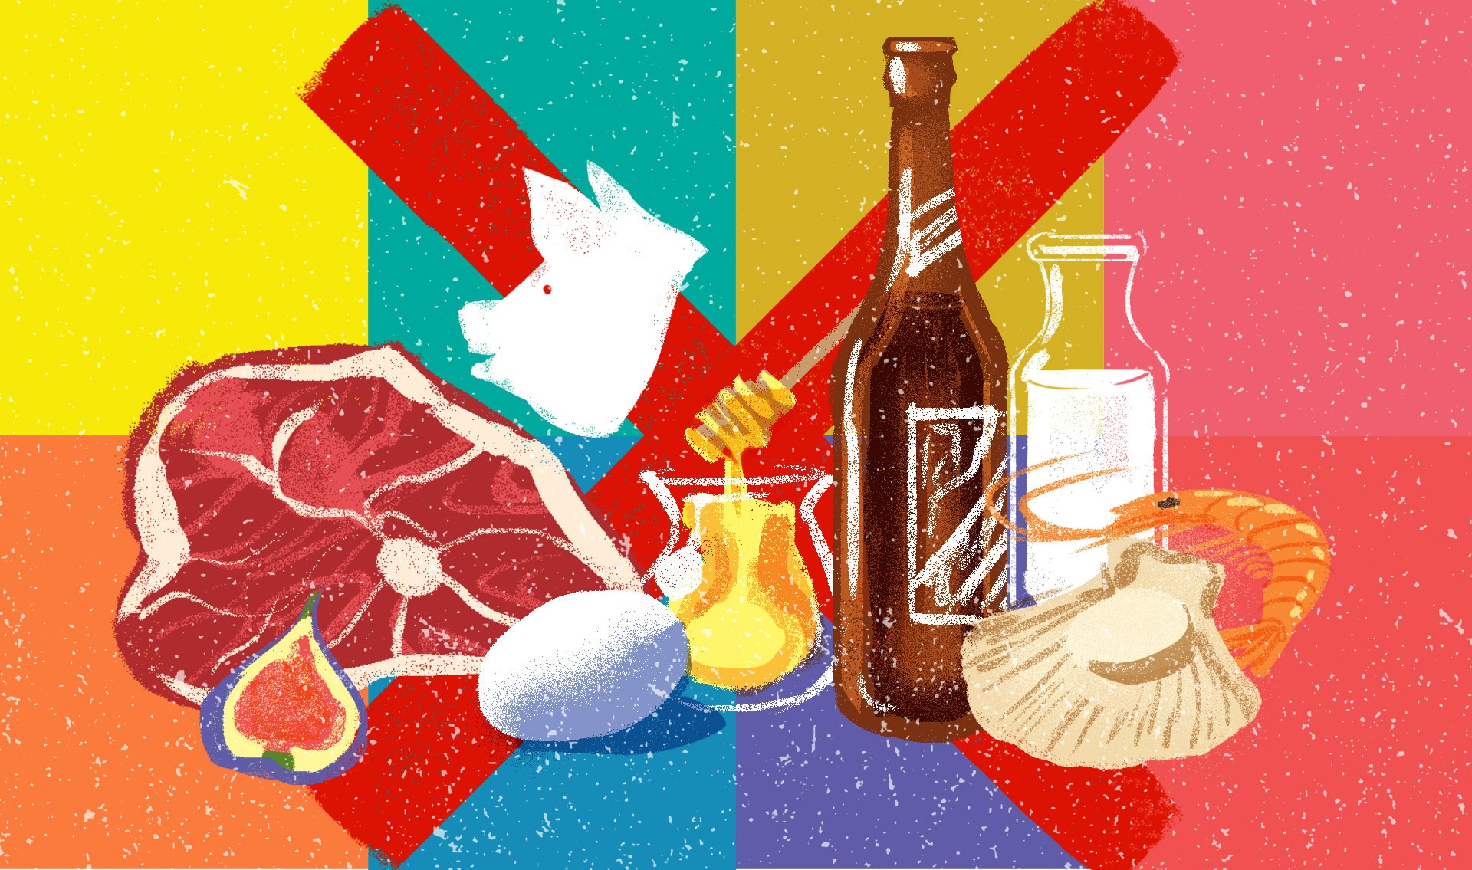
Religions inform diets and well-being
Many major world religions forbid the consumption of certain types of food.
Religious norms-> Diet-> Health-> Economic growth
We examine dietary restrictions around beef consumption in India and measure their effects on women’s health.

Slide 4
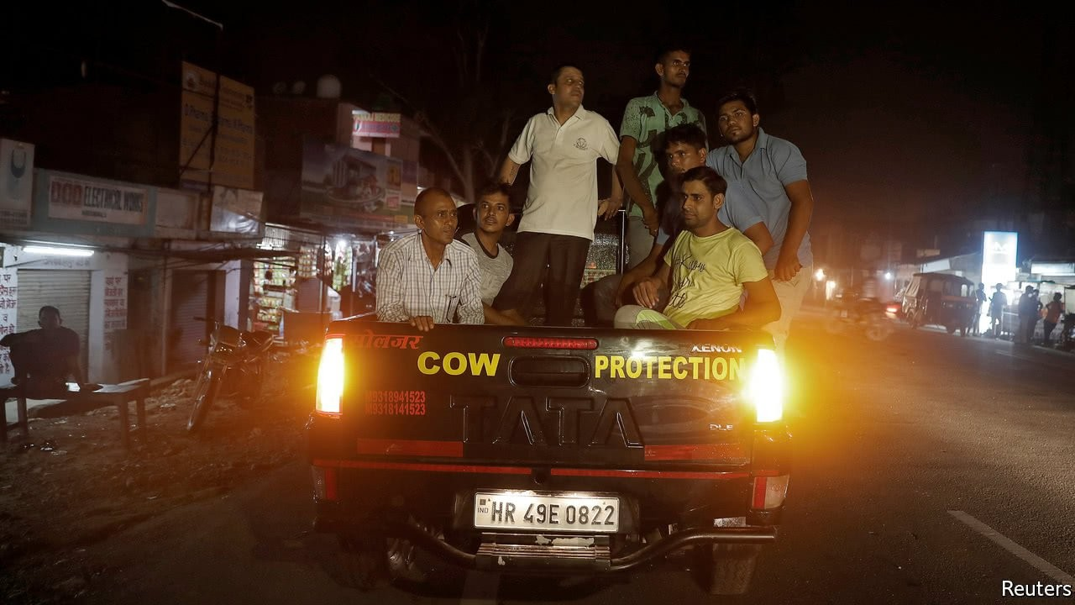
Cows in the Indian context
Cows are sacred in several Indian religions
Majority of Indian states currently ban cow slaughter and beef.
High stakes: Cow vigilantes attack and kill people
37 attacks reported in 2017 alone, as per the Economist.
“Beef bans” differentially affect beef consuming religious minorities.
We collect and analyze panel data on beef possession and sale bans and cattle slaughter bans.

Slide 5
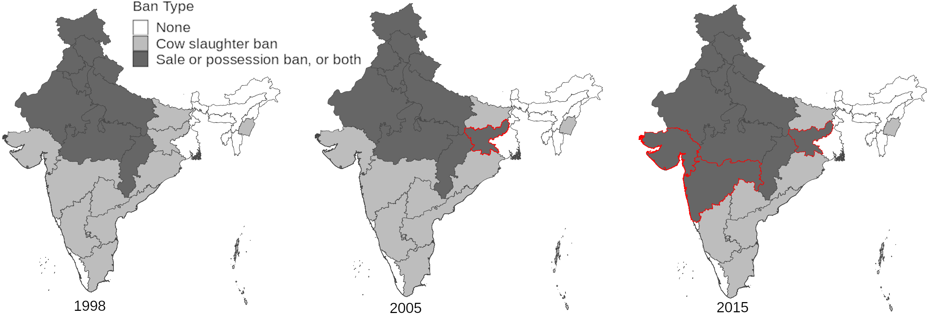
Bans on possession/sale of beef in India have increased over time

Slide 6
Do bans on possession/sale of beef affect the frequency and severity of anemia among women?
Bans on possession/sale of beef
Restricts availability of beef - a cheap source of heme-iron
Limits diet during women’s prime reproductive age
Increases frequency and severity of anemia

Slide 7
Effects of beef bans on anemia/Hg
𝑌_{ihst} = 𝛼 + 𝛽₁Ban on Beef Possession/Sale_{s,t} x Beef consumer_{ist}+
𝛽₂𝑋_{ihst} + 𝑔(i, s, 𝑡) + 𝑈_{ihst}

Slide 8
Beef bans increase anemia
 | (1) | (2) | (3)
 | Hemoglobin | Moderate Anemia | Severe Anemia
Ban on Beef Possession/Sale x Beef Consumer | -1.459*** (0.295) | 0.0251*** (0.00539) | 0.00837*** (0.00190)
Bootstrapped p value | 0.0852 | 0.0375 | 0.0647
Observations | 530544 | 530544 | 530544
Mean of Dep. Variable | 117.5 | 0.273 | 0.0233
SD | 16.23 | 0.445 | 0.151

Slide 9
Results are robust
Event study specification
Natural experiment with state split of Jharkhand from Bihar

Slide 10
Beef bans have bite
 | (1) | (2) | (3)
 | Beef price | Mutton price | Pork price
Ban on Beef Possession/Sale | 10.85** (4.790) | 27.78*** (4.514) | 15.98** (6.562)
Bootstrapped p value | 0.384 | 0.0465 | 0.343
Observations | 558483 | 571880 | 561067
Mean of Dep. Variable | 67.70 | 174.6 | 96.17

Slide 11
Summary
This paper compiles rich historical data to measure the effect of beef bans - as an example of cultural differences - on women’s health.
We use a variety of differences-in-differences models plus an event study.
Our results show that bans on beef possession/sale increase anemia among Indian women.

Slide 12
Learn more about this paper and my work through:
Website: https://sites.google.com/site/mfarhanmajid/
Twitter ID: M_FarhanMajid
Email: fmajid@impaqint.com

