Slide 1
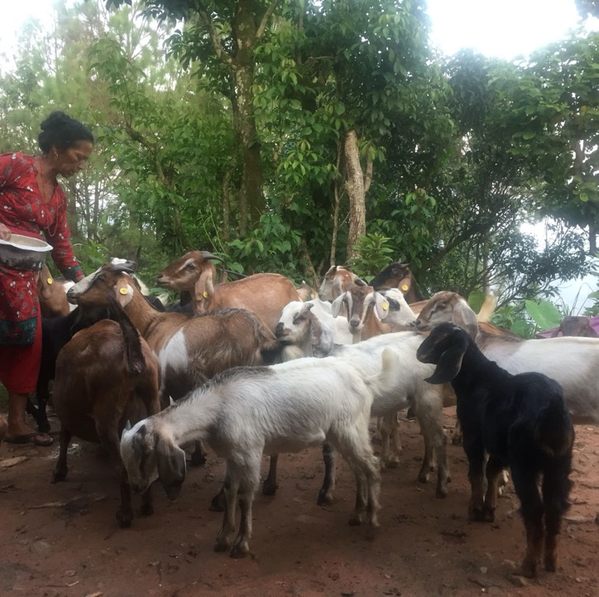


Using the livestock vaccine value chain to transform outcomes for women livestock owners: intersectionality & causal pathways
Nargiza Ludgate (rnargiza@ufl.edu)
University of Florida
Cultivating Equality Conference
14 October 2021
Notes:
Photo credit: Adi Gangga, 2019

Slide 2
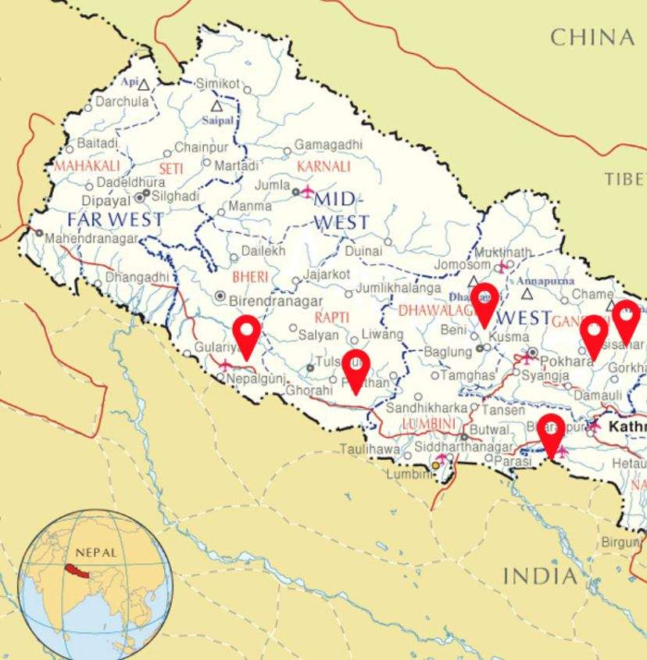
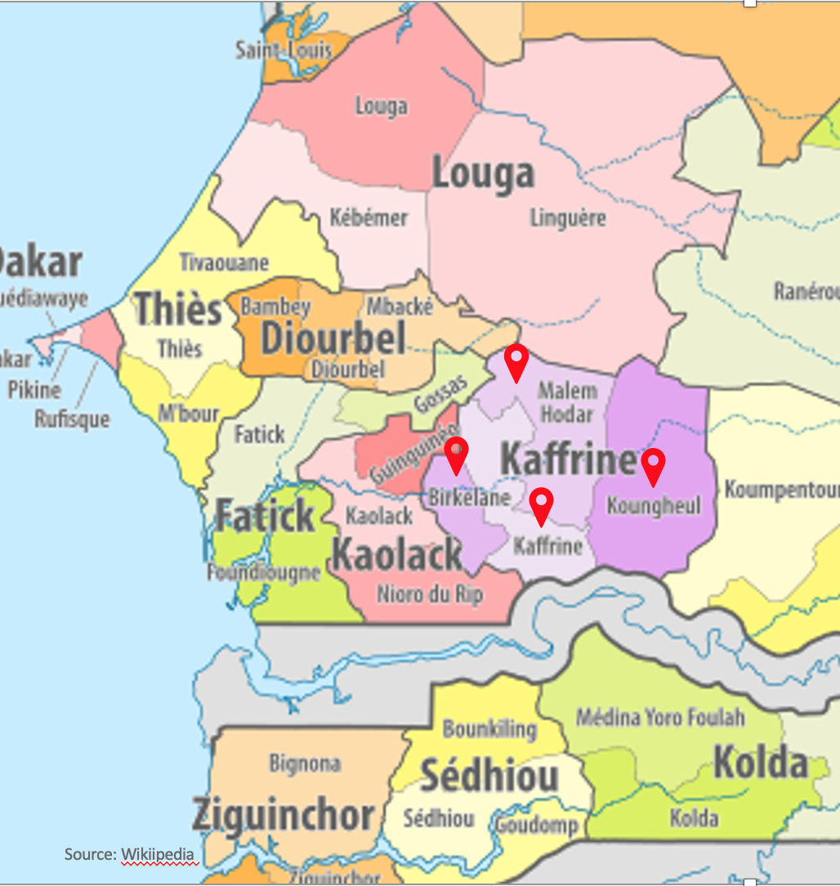
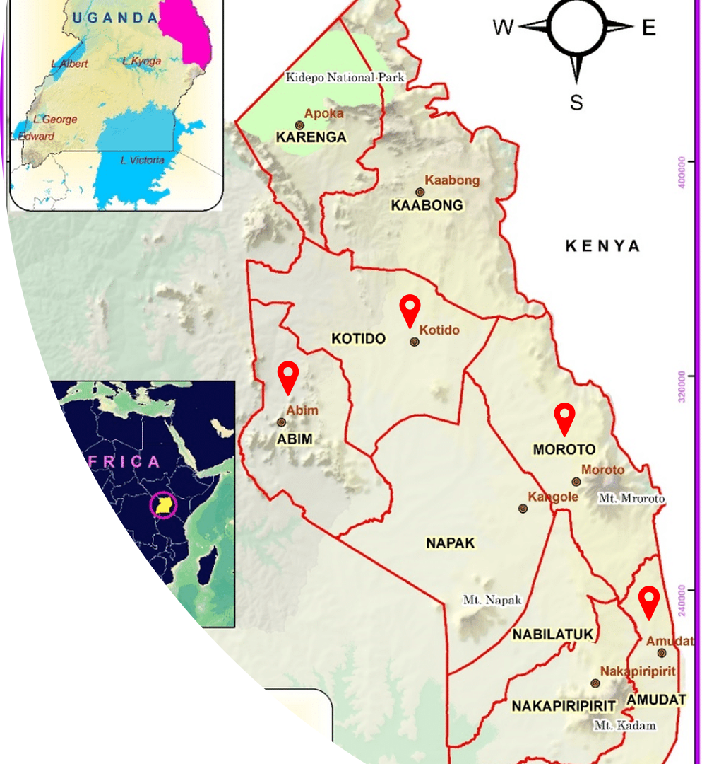
Research project: Advancing women’s participation in livestock vaccine value chains in Nepal, Senegal and Uganda
  Nepal: Six districts – PPR vaccine for goats
  Senegal: Kaffrine Region - PPR vaccine for shoats and New Castle vaccine for poultry
  Uganda: Karamoja Sub region – PPR vaccine for shoats

Slide 3
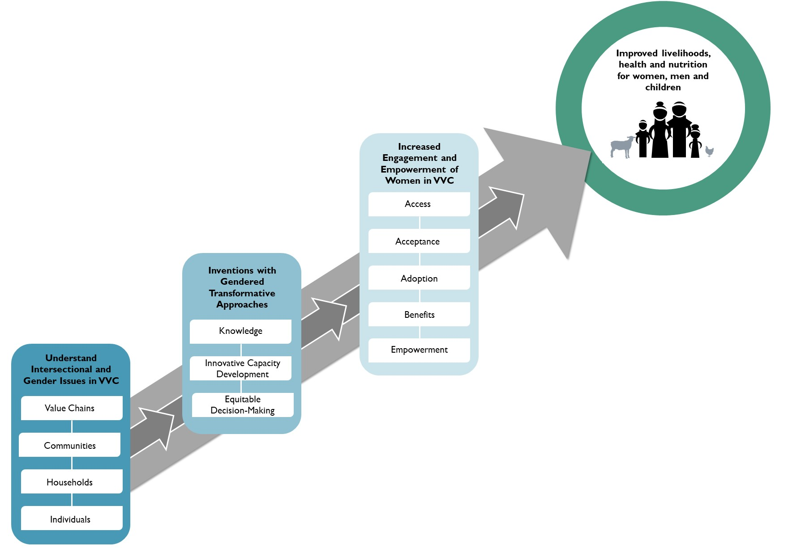
Our Theory of Change

Slide 4
Why livestock vaccine value chains (LVVC)
Livestock sector is a highly gendered space
Technical and gender issues of vaccine access/use are only part of the problem
Focus on small ruminants and poultry, which are highly valuable to women and marginalized communities

Slide 5

Research questions
RQ1: How do gender and intersectionality contribute to a better analytical tool for understanding women’s engagement in the LVVC?
RQ2: Do country specific interventions that build upon GITA lead to greater women’s participation in the LVVC?
RQ3: Does greater women’s participation in the LVVC lead to greater vaccine uptake by women?

Slide 6
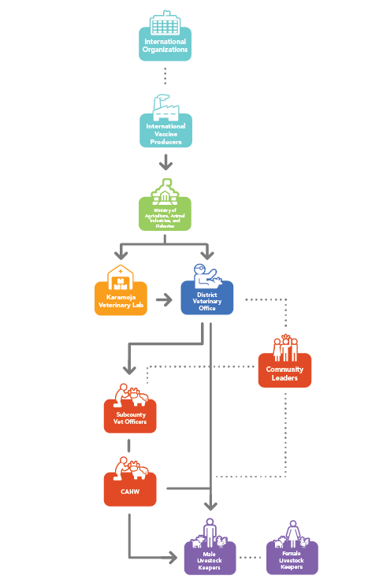
Mapping of the PPR vaccine distribution system in Uganda
Vaccine flow
Information flow
Karamoja Sub – a PPR disease hotspot
PPR vaccine is imported by government and international organizations
No private sector
CAHWs are key for livestock vaccinations
Women are systematically left out on the lower nodes of the value chain

Slide 7
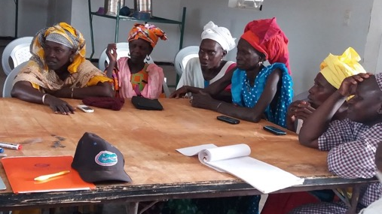
Concept of causal pathway
Current situation – animals belonging to women and marginalized groups are less likely to be vaccinated
Desired outcome – inclusive, equitable, and efficient vaccine uptake
Multi-level livestock vaccine value chain system and multiple entry points
Notes:
Photo credit: Pierre William Blanc, 2019

Slide 8
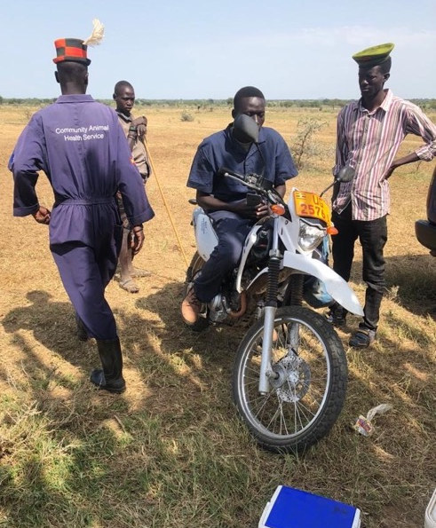
Entry points to mapping the causal pathways
Identifying nodes and points of entry
Theory of Change – if, if, if, then
What will be effective to address / change behavior
National to local
  Curriculum & policies at national level
  "Practices" at local level
Notes:
Photo credit: Daniel Acosta, 2018

Slide 9
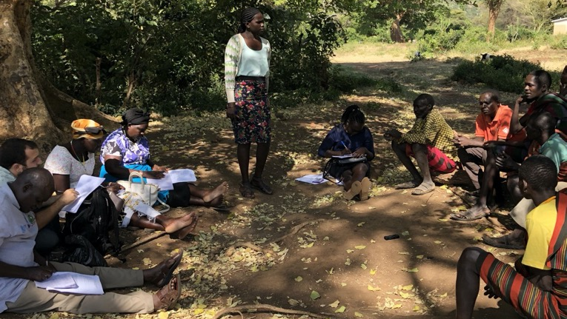
What do we know about causal pathways to inclusive value chains?
Heterogenous
Gendered intersectional analysis matters
Context specific
Require different approach to development
Require different approach to scaling
Notes:
Photo credit: Nargiza Ludgate

Slide 10
Causal pathways toward desired outcome
 | A | B | C | D
 | Actors and/or actions in the nodes in LVVC | Intersectional understanding | Interaction A x B & implications | Empowerment Outcome
1 | Communities sensitized using GITA | Social and cultural norms about who has access to vet services | Transformational potential of outreach | Vaccine uptake is inclusive, equitable and efficient
2 | Trained veterinarians with GITA | Social and cultural norms about who provides animal health care | Transformational potential of trainings
3 | Trained community animal health workers with GITA | Social and cultural norms about who receives animal health care | Transformational potential of trainings
4 | Community animal health workers curriculum supplemented with GITA | Norms about technical vs. soft skills training | Transformational potential of curriculum reform
5 | GITA infused livestock vaccination policies | Belief that policies are neutral | Transformational potential of policy reform

Slide 11
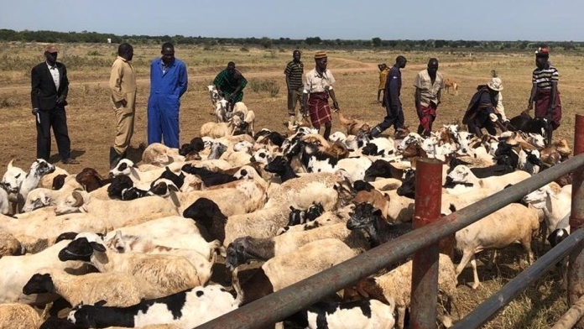
Research continues…
Notes:
Photo credit: Daniel Acosta, 2018

Slide 12
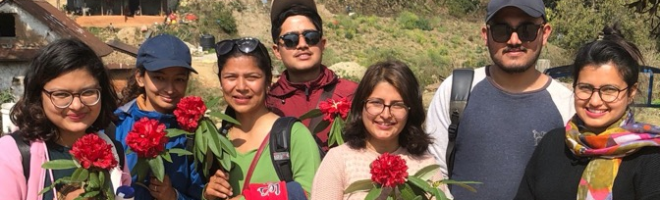
Thank you!
This presentation was made possible for the Livestock Vaccine Innovation Fund. The Livestock Vaccine Innovation Fund is supported by the Bill & Melinda Gates Foundation (BMGF), Global Affairs Canada (GAC), and Canada’s International Development Research Center (IDRC).
The views expressed herein do not necessarily represent those of IDRC or its Board of Governors.
Notes:
Photo credit: Nargiza Ludgate, 2020

Slide 13


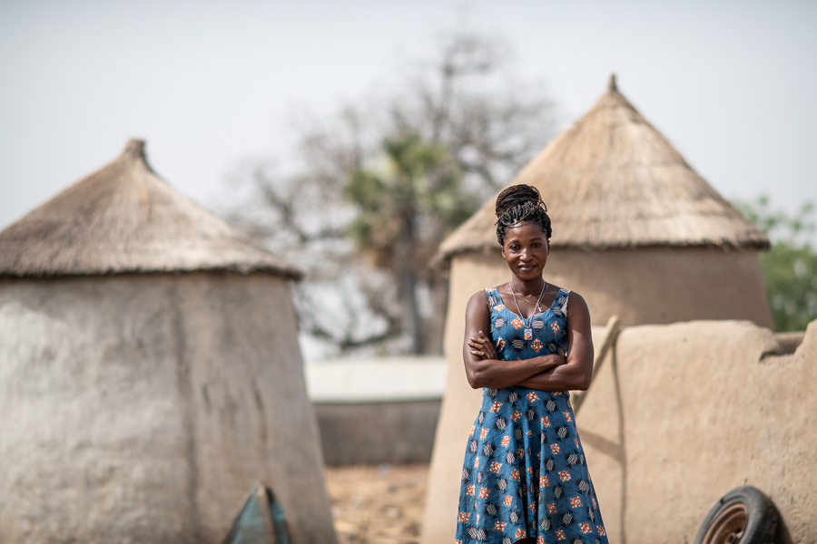

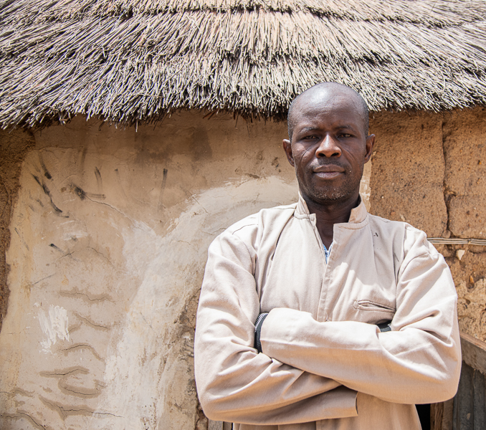
Transforming the vaccine delivery system for chickens and goats in Ghana: what approaches and what benefits for women?
Alessandra Galiè*, Immaculate Omondi**
*a.galie@cgiar.org; **i.omondi@cgiar.org
International Livestock Research Institute (ILRI)
In collaboration with CARE and CowTribe
Cultivating Equality Conference
14 October 2021

Slide 14
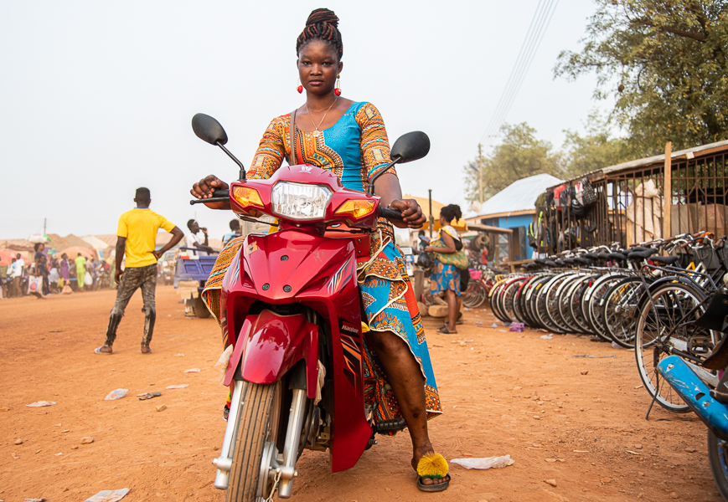
The project in a nutshell
Goal: institutionalized gender-responsive vaccine system for enhanced nutrition security and women’s empowerment
Research questions: 1. What does a gender-responsive vaccine system look like?
2. How is a transformative approach affecting women’s ability to benefit from vaccines as compared to an accommodative approach?
What we do: we test two approaches for vaccine delivery — one gender accommodative (GAA) and one gender transformative (GTA) — to facilitate women’s sustained involvement in livestock vaccination in 2 regions in north Ghana.
We use the Women’ Empowerment in Livestock Index (WELI) to measure women’s empowerment
Partners:
CARE-lead, field implementation, GTA experience
ILRI, scientific design and analysis
Cowtribe, private vaccine provider

Slide 15
PROJECT INTERVENTION
SHORT-TERM IMPACT
MEDIUM-TERM IMPACT
LONG-TERM IMPACT
Engage women farmers
Access to info & vaccines with Cowtribe; access VLAs; address gender norms
Farmers use Cowtribe system
Women farmers benefit from vaccinated livestock
ND and PPR vaccines available
Women farmers vaccinate their livestock
Vaccinated livestock more productive
Women AHSPs effectively reach women farmers
Empowerment of women farmers and AHSPs
Engage women AHSPs recruit young AHSPs; enhance capacity; address gender norms
Women AHSP succeed in business
More Women AHSP involved in business
Cowtribe effectively reaches farmers
Households, communities, AHSPs, extensionists
support new AHSPs
Households & communities appreciate value of women’s vaccinated species
Gender-responsive animal vaccine system institutionalized
Conducive gender norms social media campaign; community dialogues; support champions
Current vaccine system is amenable to gender-responsive change
Households & communities support animal vaccines for women’s species; and women enjoying benefits
Policy makers want vaccines to reach women farmers
Policy makers see value of gender-responsive vaccine systems
Improved household nutrition
Equitable vaccine system involve policy makers; Cowtribe electronic system gender-responsive
Policy makers support women AHSPs and start changing the vaccine system
Diverse food are available and accessible
Households use increased productivity for better diets
Campaign on healthy diets
Households know healthy diets

Slide 16


PROJECT INTERVENTION
SHORT-TERM IMPACT
MEDIUM-TERM IMPACT
LONG-TERM IMPACT
Farmers use Cowtribe system
Engage women farmers
Access to info & vaccines with Cowtribe; access VLAs; address gender norms
Women farmers benefit from vaccinated livestock
Women farmers vaccinate their livestock
Vaccinated livestock more productive
Empowerment of women farmers and AHSPs
Engage women AHSPs recruit young AHSPs; enhance capacity; address gender norms
Women AHSP succeed in business
More Women AHSP involved in business
Households, communities, AHSPs, extensionists
support new AHSPs
Households & communities appreciate value of women’s vaccinated species
Gender-responsive animal vaccine system institutionalized
Conducive gender norms social media campaign; community dialogues; support champions
Households & communities support animal vaccines for women’s species; and women enjoying benefits
Policy makers see value of gender-responsive vaccine systems
Improved household nutrition
Equitable vaccine system involve policy makers; Cowtribe electronic system gender-responsive
Policy makers support women AHSPs and start changing the vaccine system
Households use increased productivity for better diets
Households know healthy diets
THE STUDY WE PRESENT TODAY
Campaign on healthy diets

Slide 17
Study on vaccines and empowerment

Slide 18
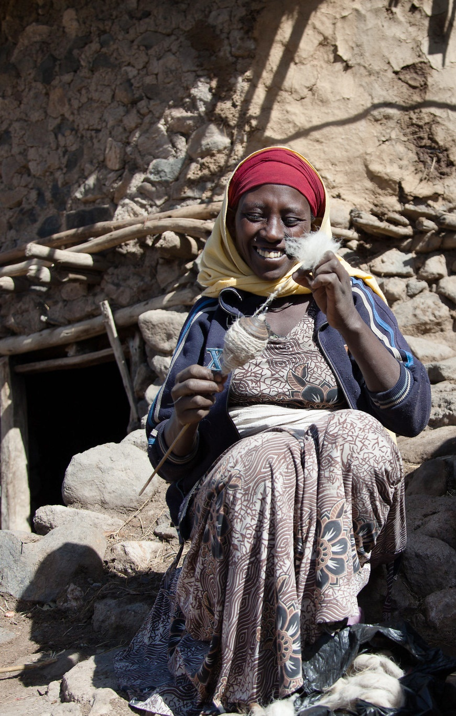
What we wanted to know?
  Is there a significant relationship between empowerment and different aspects of vaccines
    i.e. does access to vaccines, knowledge about vaccines, participation in vaccines etc influence empowerment?
  How do the empowerment subdimensions relate to vaccine aspects?
    i.e. is there a significant difference in the relationship between different aspects of vaccine and the subdimensions of WELI?
What for?
Identify intervention areas that optimize women’s (and men’s) participation and their benefits
    explore the link between women’s empowerment in livestock and knowledge, access and participation in vaccinations for small stock

Slide 19
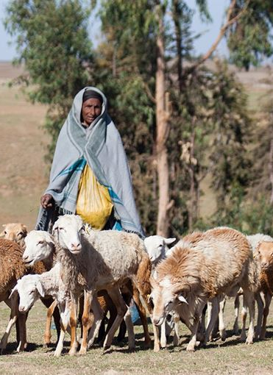
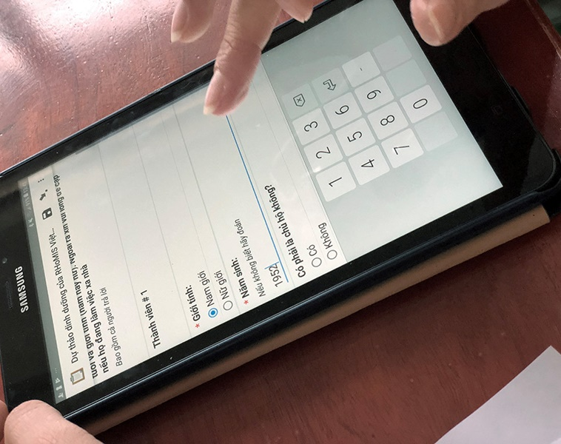
Method
The study:
  explores what subdomains of empowerment are most significant (WELI quantitative analysis)
  applies SEM technique to examine this complex phenomenon
    Partial least squares – structural equilibrium model (PLS-SEM)
    PLS-SEM captures the internal relationships within an equation
    PLS-SEM is useful because:
      It places fewer limitations on sample size and data distribution
      It is appropriate to build theory and explore models with cause-effect relationships
      Smart PLS 3 - a multivariate analysis method of s is employed

Slide 20
Results
CA values and CRs were higher than, or closer to the recommended value, of 0.700, for achieving internal consistency reliability
Convergent validity assessed by AVE - the values exceed the threshold of 0.4
Reliability and validity tests
x\zx\zx\z
Constructs | Variable name in the data | Females |  |  |  |  | Males
 |  | λ | CA | rho_A | CR | AVE | λ | CA | rho_A | CR | AVE
Access to vaccines | access_g10_ppr_6_suppliers | 0.821 | 0.662 | 0.697 | 0.853 | 0.744 | 0.820 | 0.664 | 0.703 | 0.854 | 0.745
 | access_g10_ppr_9_afford | 0.902 |  |  |  |  | 0.905
Knowledge of vaccines | KnowAccs_g10_ppr_17_accInfo | 0.929 | 0.742 | 0.793 | 0.883 | 0.791 | 0.928 | 0.839 | 0.839 | 0.925 | 0.861
 | KnowVac_g10_ppr_14_anhealth | 0.847 |  |  |  |  | 0.928
Participation in vaccination | partcp_g10_ppr_1_vaccinated | 0.941 | 0.805 | 0.887 | 0.886 | 0.727 | 0.924 | 0.757 | 0.861 | 0.860 | 0.681
 | partcp_g10_ppr_vacPurchs_whoPays | 0.946 |  |  |  |  | 0.925
 | partcp_g10_ppr_vac_whoPurchase | 0.632 |  |  |  |  | 0.577
WELI | assetownership_ndepr | 0.694 | 0.352 | 0.374 | 0.751 | 0.604 | - | - | - | - | -
 | feelinputdecagrl_ndepr | 0.852 |  |  |  |  | -
 | feelinputdecagrl_ndepr | - | - | - | - | - | 0.851 | 0.647 | 0.649 | 0.850 | 0.739
 | Incomecontrol__ndepr | - |  |  |  |  | 0.869

Slide 21
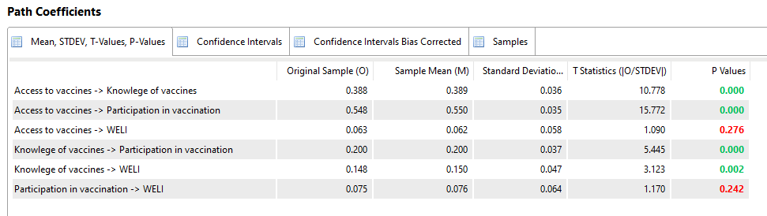
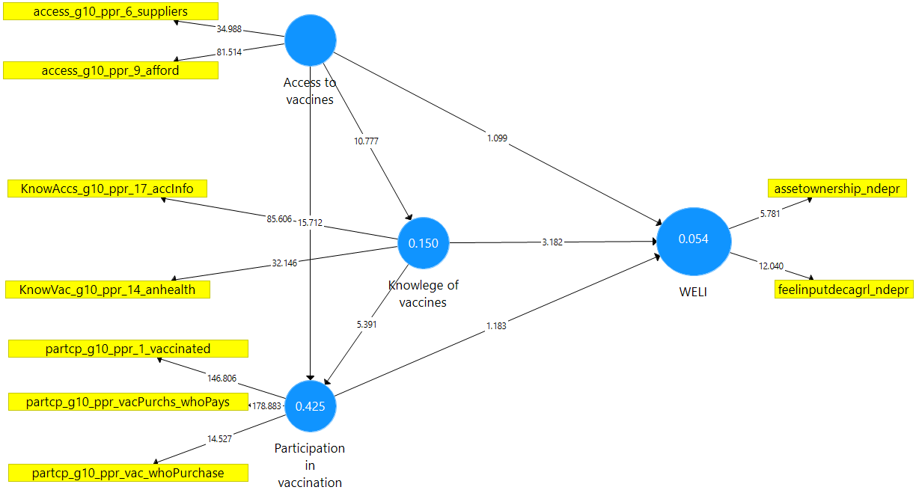
Results
Key subdomains of empowerment
Structural model and mediation analysis for women goat keepers

Slide 22
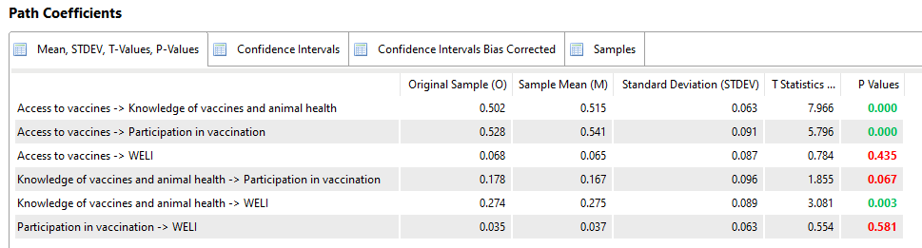
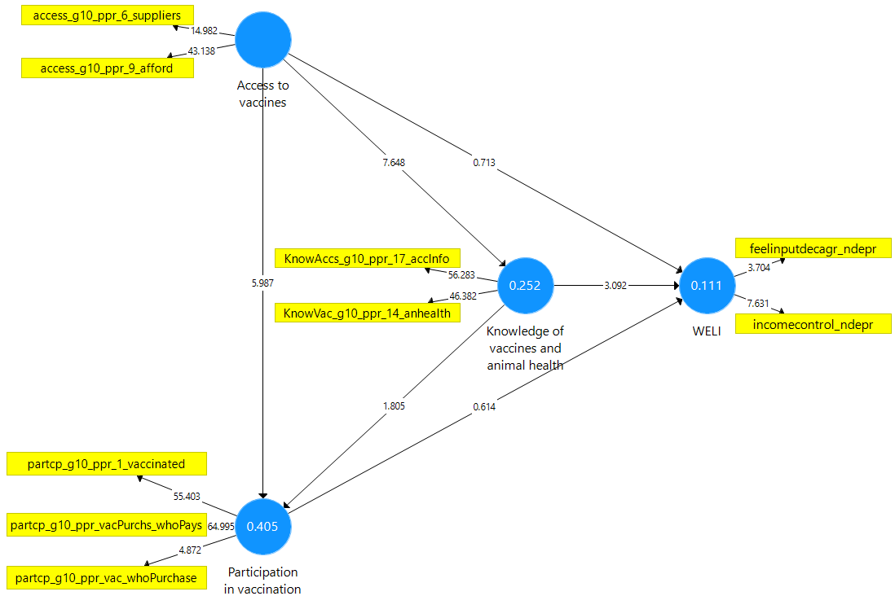
Results
Key subdomains of empowerment
Structural model and mediation analysis for men goat keepers

Slide 23
Observations from results
Significant difference between male and female respondents in empowerment measure, WELI
  Females – ‘asset ownership’ and ‘input into decisions on livestock production’ subdimensions strongly constitute/ represent empowerment
  Males – ‘control of income’ and ‘input into decisions on agricultural production’ key subdimensions
Strong positive association knowledge about vaccines - empowerment for both women & men
Participation in vaccination does not significantly influence WELI values, however:
    It is strongly influenced by access to vaccines
    access to vaccine influences knowledge of vaccines which also influences participation in vaccination (Mediation effect)
Access to vaccines exhibits an indirect effect on WELI values since it significantly influences knowledge, which in turn has a strongly significant positive association with WELI

Slide 24
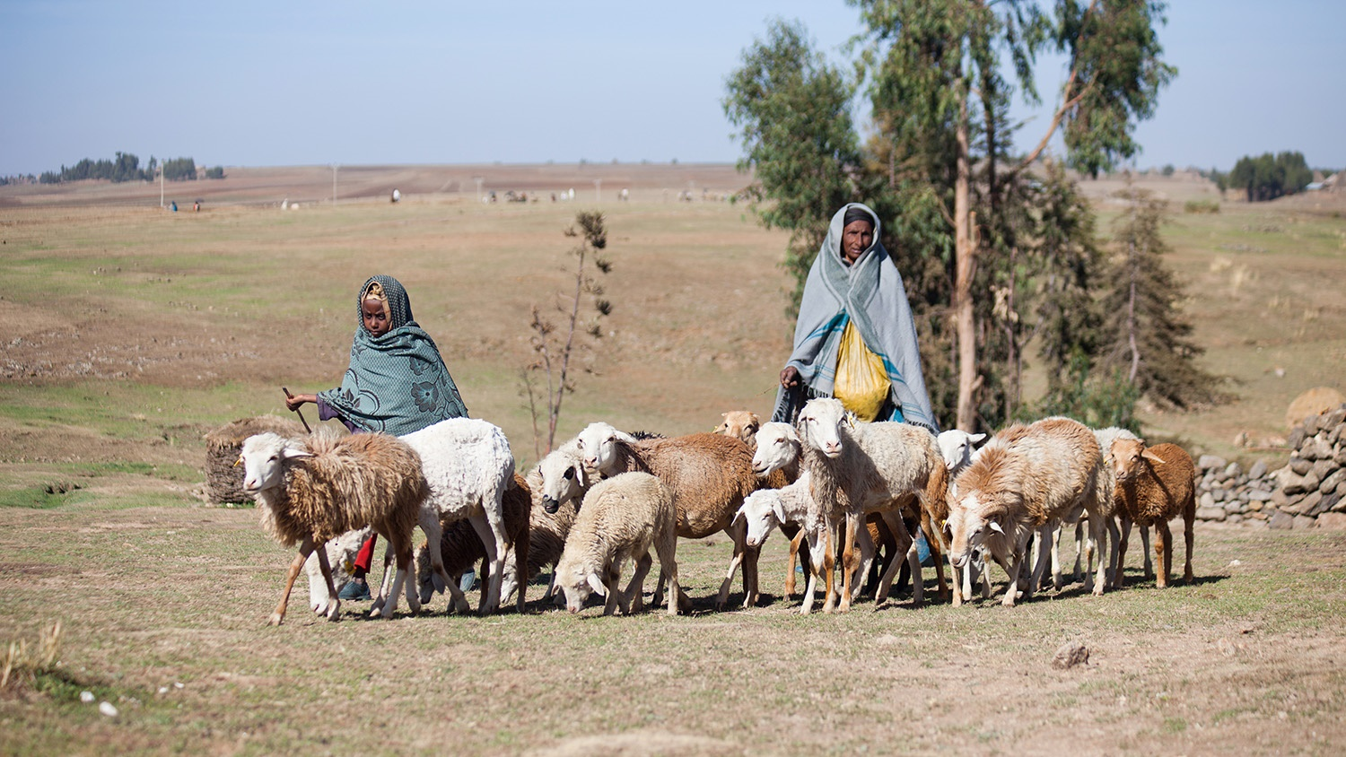
Implications on gender-responsive animal vaccine system
To support women’s empowerment, we need to strategically support their:
  Livestock asset ownership
  Input into decisions on livestock production
  Knowledge on animal health and vaccines
  Access to vaccines

Slide 25



Systemic transformational change and empowerment for women smallholder farmers through engagement of key critical partners
Jemimah ODUMa - Shevax+
Notes:
The title of our presentation is systemic transformational change and empowerment for the women small holder farmers through engagement of key critical partners., In this model we use outcome mapping as a tool to analyze the systems that are barriers across the vaccine value chain, and develop opportunities to create an enabling environment that will sustain outcomes at scale after the project has ended.

Slide 26
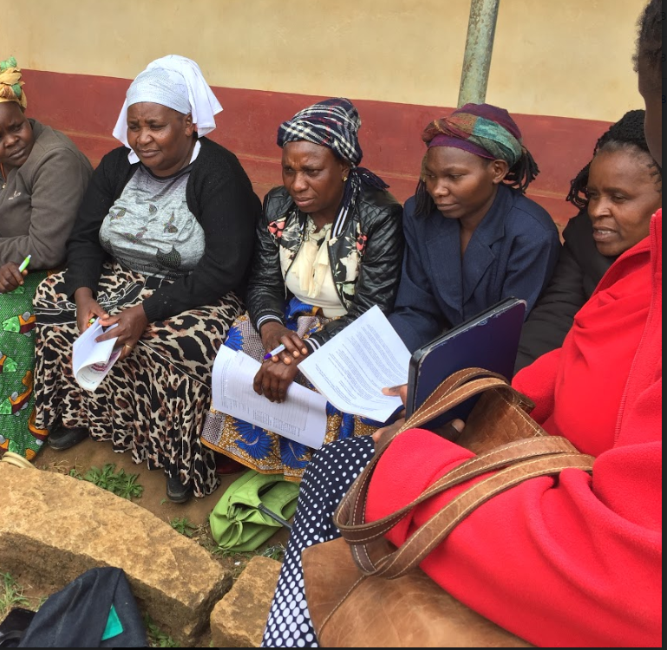
Hearing their voices: Action research to support women’s agency and empowerment in livestock vaccine distribution, delivery and use in Rwanda, Uganda and Kenya.
Funded by IDRC-LVIF

Slide 27
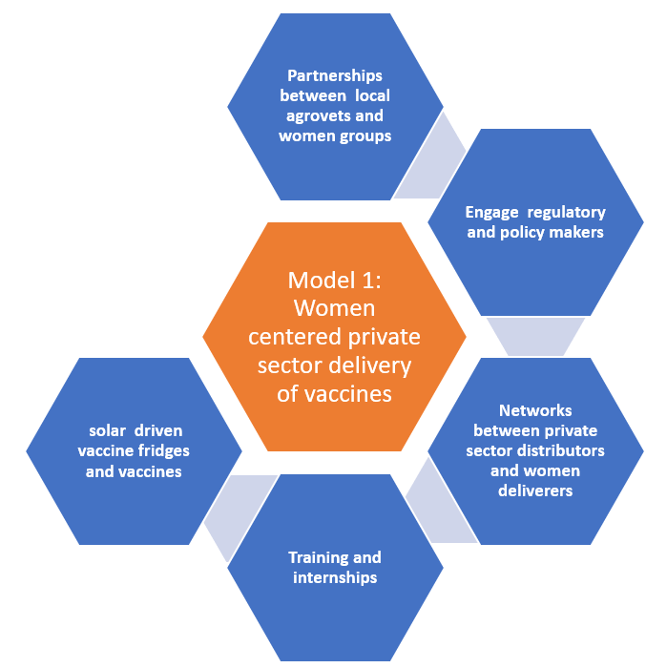
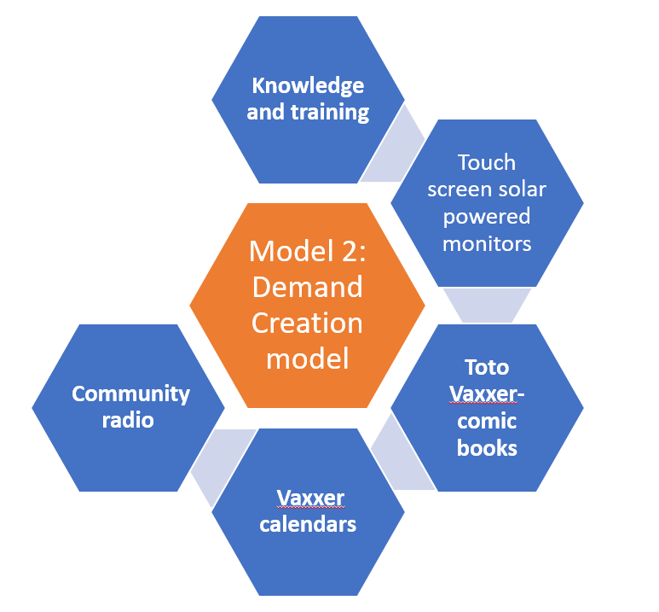
INCREASED VACCINE ADOPTION THROUGH
Increased vaccine accessibility
Increased
vaccine
Demand
Notes:
We have created two models. Model 1: A women-centered private sector delivery model for vaccines (tested mostly in Uganda and numbers bumped up slightly in Kenya). Model 2: A demand creation model (tested in Rwanda).
These models target women’s individual and collective processes which address issues of entrepreneurship, self-reliance, and cooperation to challenge power structures. They are potentially beneficial to women small holder farmers along the VVC as end users, entrepreneurs, service providers and distributors.

Slide 28
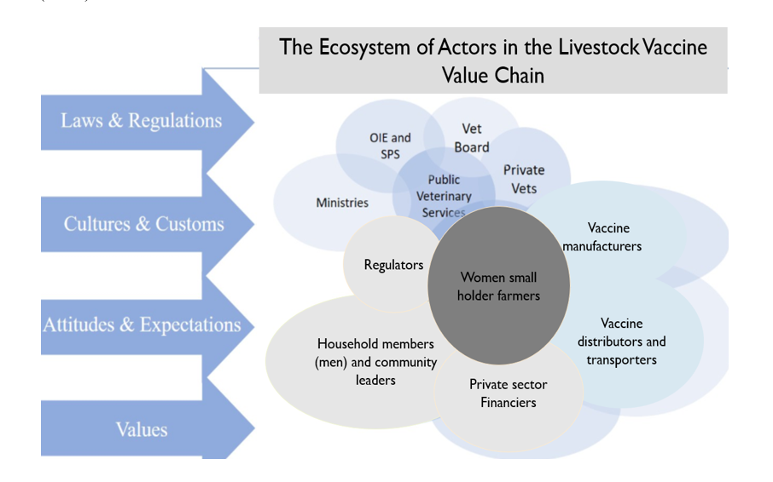
Notes:
Our theoretical framework focuses on the interrelations between our women small holder farmers and the other key players in the vaccine value chain (VVC).
We look at the vaccine value chain as an ecosystem of many actors, each one of them contributing to our ultimate vison of women empowerment along the VVC where women’s capabilities (skills, education, health) and agency (participation, voices, influence) are strengthened.

Slide 29
NCD Vaccine & Poultry Value Chain
MOALFI
Ministry of Health
International Organizations: OIE, FAO
2
1
Vaccine movement
1
Live poultry movement
Vaccine R&D
Exporter
Regulators
1
Regulator VMD/KVB/DVS
1
Consumers
3
Vaccine Supplier
Extension workers
2
Drug Company (Importer/ Manufacturer)
1
2
3
Transporter
Power
Main Distributor
1
3
2
Day Old Chick Supplier
Sub-Distributor (e.g. Chemist, Agrovet
2
Informal distributors
2
1
Extension Worker
1
Private Technical Consultant
Market
Brooker
1
Small Farmer
Large Farmer
1
2
Notes:
Kenya VVC stakeholder map for poultry value chain Consumers Market Regulators
SIDAI Africa Limited – Big business similar to an agrovet but bigger and assist with training and franchising
K’LIFT – NGO that offers credit for animal health businesses
Big corporations need to develop social responsibility

Slide 30
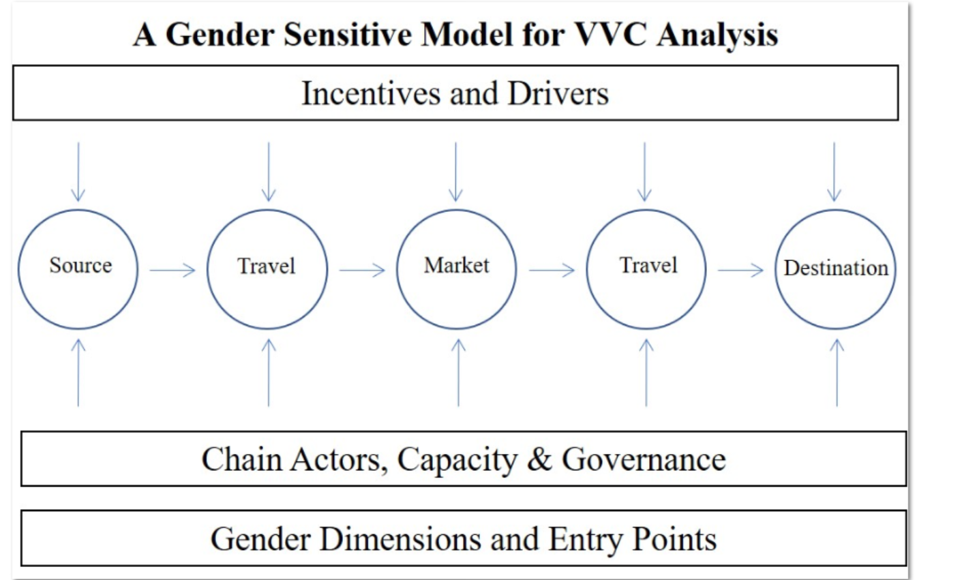
Notes:
In this case we analyze the capacities of key actors, recognize what drives them, and incentives and based on tat dentify gender dimensions and viable entry points into the LVVC

Slide 31
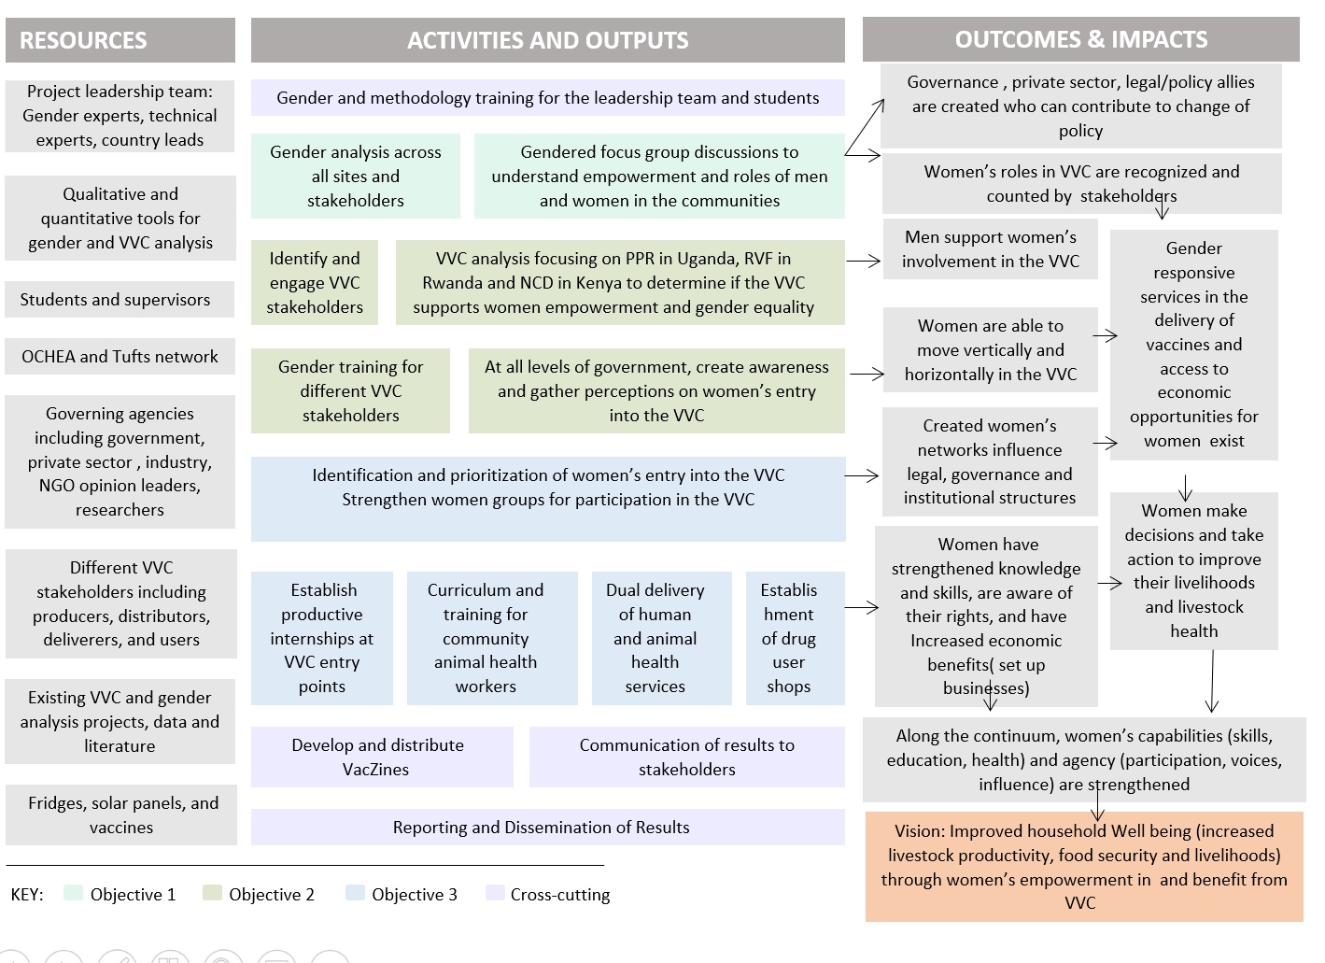
Notes:
In our Theory of change, creating allies and an enabling environment is important. For sustainability Go over outcomes and impacts and pont out the crtica partners included- governance structures, private sector men as womens support, policy makers, vaccine deliverers and users

Slide 32

Why WE use
Outcome Mapping?
Outcome Mapping (OM) is a structured participatory tool that uses a bottom-up collaborative process to engage all Spillover Ecosystem stakeholders (both traditional and non-traditional)
Through the OM process, stakeholders will map their outcomes and work to identify, design and implement interventions to address spillover.
The OM process focuses on effecting changes in behavior, relationships, actions, and activities in the people, groups, and organizations that will lead to stopping spillover.
Allows stakeholders to MAP their expected OUTCOMES

Slide 33
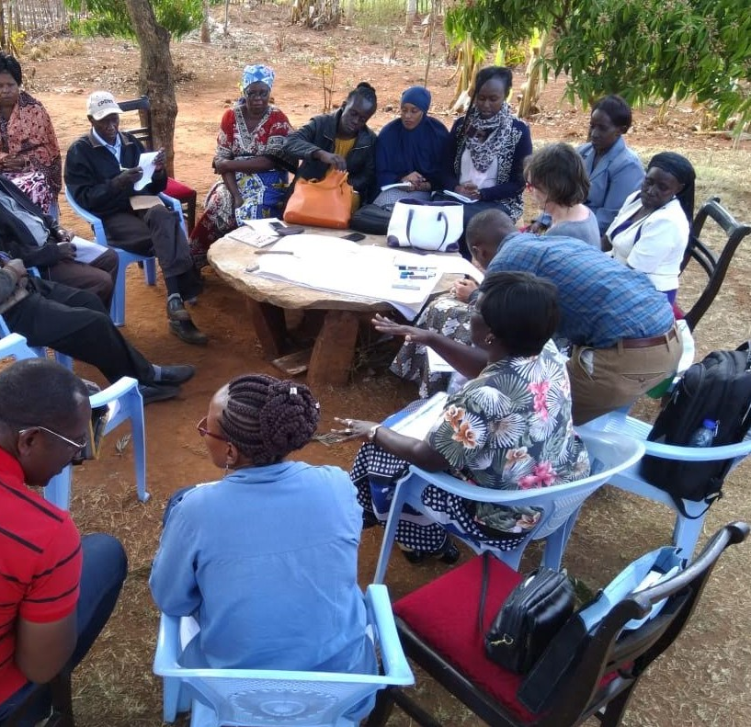
OM is about:
Systems in a Room
Listening to local actors and allowing them to define their role: communities, civil society, the private sector, academia, and ministries.
Understand Local Systems. Identify key local actors, understand relationships and interdependencies, and support local actors in developing and leading their own development solutions/interventions that positively transform systems.
Build networks and relationships between local actors that lead to enduring positive systemic change and sustainability.
Support Local Leadership. Shift priority-setting, decision-making, leadership, and power to local actors. Support local actors in identifying, achieving, and measuring their own priorities.
Measure what matters to local actors - and measure whether and how locally led collaboration results in systemic change, and behavior change, including unexpected outcomes.

Slide 34
Outcome mapping approach
Identify and systematically engage critical multisectoral partners to achieve the project vision.
Use a process of analyzing current limitations (social, political, and cultural norms), challenges (barriers to partner support) and opportunities (both systemic and programmatic).
Create an enabling environment and a change in the surrounding systems for ensuring women engage, participate, benefit and can influence the VVC.
Establish sustainable networks and partnerships between vaccine end users, deliverers and distributors that go beyond the project life.
Engage regulators and policy makers to examine regulatory mechanisms that can create gender sensitive vaccine delivery systems.
Create opportunities for effective and efficient vaccine distribution chains.

Slide 35
Critical Partner | Their role | Example of Outcome
Women | Small holder farmers and female actors along the VVC | Women have agency and can make decisions, take action to improve their livelihood, and create networks that influence legal governance and institutions. Knowledge and skills on vaccines are continuously strengthened.
Men | These are the husbands, heads of households community leaders, men along the VVC | Men continuously and increasingly support women’s participation and engagement and systems for women to effectively engage and benefit from VVC.
Government | Policy makers and regulators of vaccines | Creation of gender responsive policies specific to VVC developed. A change in discourse discussing gender issues.
Animal health service providers | DVOs, VOs, CAHWS & Agrovet dealers in both private and public sector | Increased accessibility and availability of vaccines. Continued retooling and skilling of service providers. Provide services to women smallholder farmers
Private sector: manufacturers, importers, distributors of vaccines | Manufacturers, importers and distributors of vaccine, banking institutions | Package vaccines that can be afforded by women smallholder farmers e.g. 50/100 dose vials of NCD. Deliver vaccines to rural communities. Support women entrepreneurs. Financial institutions have special packages for smallholder women farmers.
Research and academic institutions | Academic and research training institutions for professionals | Institutions carryout evidence-based studies that influence gender related decision making and policies. Training institutions imparting the relevant skills in the professionals involved in the VCC. Ensure subjects relevant to women smallholder farmers are covered adequately, e.g. poultry and goat production.
Notes:
We have engaged different critical partners. As above –then explain how you did it in Kenya through stakeholder meetings, having hem deliver trainings, help in develop materials and do community visits together

Slide 36
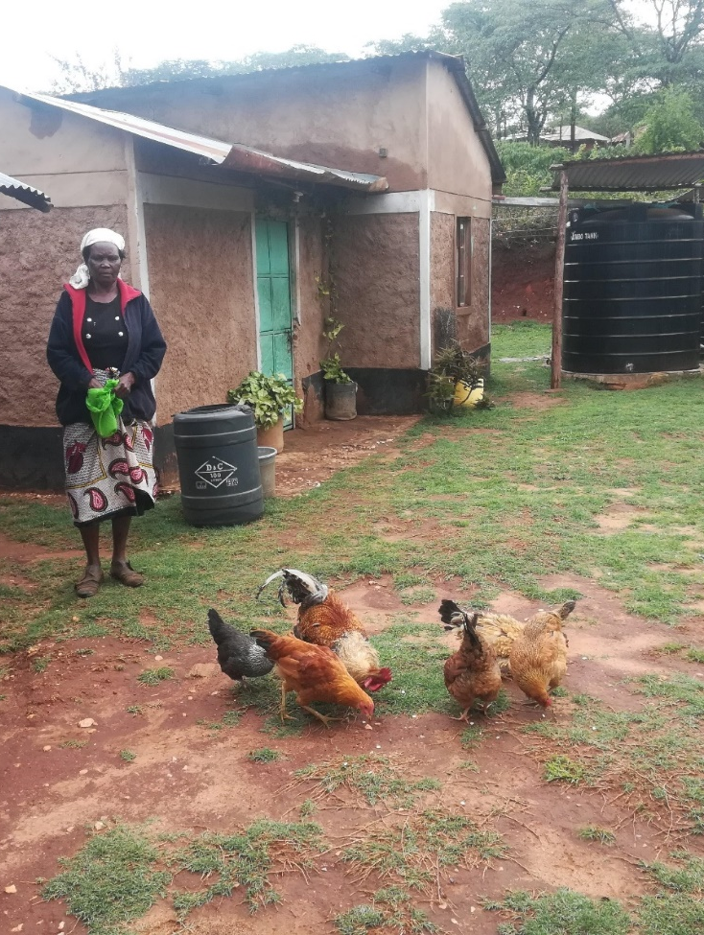
We use photovoice for women to tell their stories
Can reach policy makers, and other partners
Influence change that is occurring
A photo-story. She has a few chicken, did she have more before? What happened to the rest, did they die, if so why, were they vaccinated or not……

Slide 37
Intended outcomes
Our tools and model intensify vaccine adoption through an improved enabling environment
Increased vaccine accessibility and demand for women smallholder livestock farmers
Catalyze engagement of our critical partners from the onset, facilitating networking and collaboration between our women smallholder farmers and value chain actors with the aim of institutionalizing sustainable change in the VVC
Focus on the systems, policies and regulations that govern vaccine availability, the different chain actors and their capacity, professional knowledge, and the gender dimensions as influenced by attitudes and culture

Slide 38
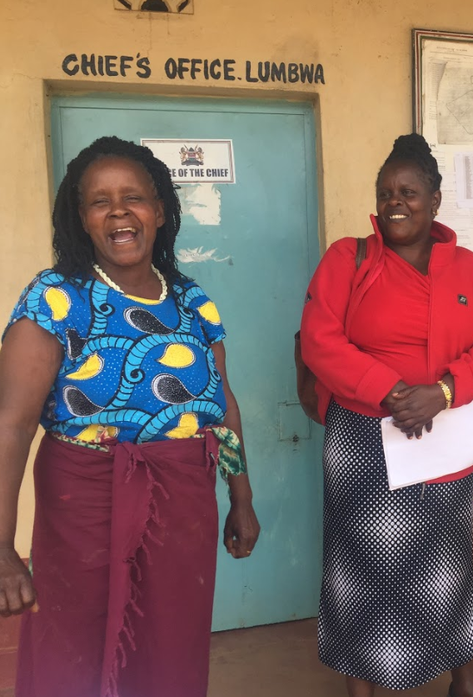
THANK YOU!
FUNDING FOR THIS PROJECT WAS PROVIDED BY CANADA’S INTERNATIONAL DEVELOPMENT RESEARCH CENTRE (IDRC) - LIVESTOCK VACCINE INNOVATION FUND WHICH IS SUPPORTED BY THE BILL & MELINDA GATES FOUNDATION (BMGF) AND GLOBAL AFFAIRS CANADA (GAC)

Slide 39



Slide 40



GENDER INCLUSIVE VACCINE ECOSYSTEM: ENHANCING DISTRIBUTION AND DELIVERY SYSTEM FOR NEWCASTLE DISEASE & CCPP AMONG SMALLHOLDER FARMERS
Cultivating Equality Conference 12th- 15th October, 2021
The University of Nairobi | The Cooperative University of Kenya | Kenya Agricultural & Livestock Research Organization
Salome Bukachi et al. Nyamongo I., Chemuliti J., Waweru K., Omia D., Ogolla K., Ngutu M., Kiganane L., Okinda O., Anyona D., Kimani W., Mbithe M., Nzioki A., Wanjiru S., Simiyu A., Nyaboke L

Slide 41
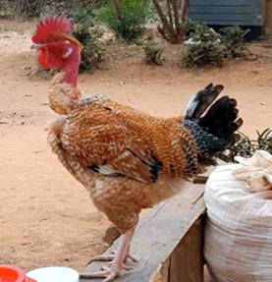
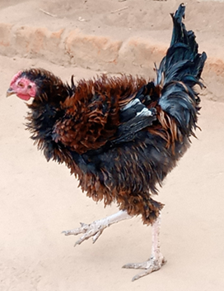
Livestock is a driver towards food security and sustainable development and is a viable pathway out of poverty for the poor especially women
Vaccines are critical yet their effective use is hampered:
The GIVE project aims to establish the most optimal vaccine delivery approach that would enhance access, uptake and utilization of the Newcastle disease vaccines and CCPP Vaccine among smallholder chicken farmers more so women.

Slide 42
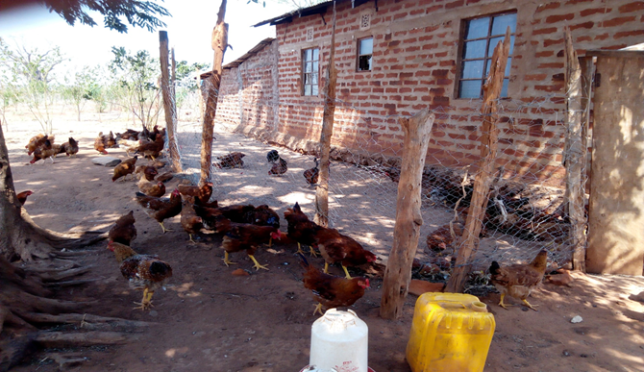
GIVE Research Objectives
To establish the vaccine knowledge among women and how it affects their ability to use and benefit from vaccines
To explore the socio-cultural, economic and technical barriers in access to ND and CCPP vaccines.
To examine norms that hinder women from owning and using livestock, participating in and benefiting from the livestock vaccines value chain, and utilizing vaccines to improve the productivity of their livestock.
To map actors who influence norms and practices that affect women’s engagement.
To identify the gender-based factors in adoption of ND and CCPP vaccines along the vaccine value chain among female smallholder farmers.

Slide 43
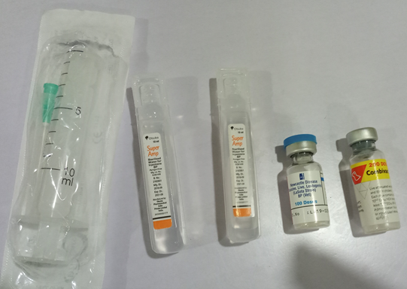
Intervention
While the diseases are vaccine preventable, the vaccination rates remain critically low especially among smallholder women farmers in Makueni County.
Project intervention: Testing two different vaccine delivery models for NCD:
  Demand Driven Model (DDM)
  Community Vaccinator Driven Model (CVDM)
  Compare them with Status quo.
  Formation/strengthening of cooperatives/peer educators

Slide 44
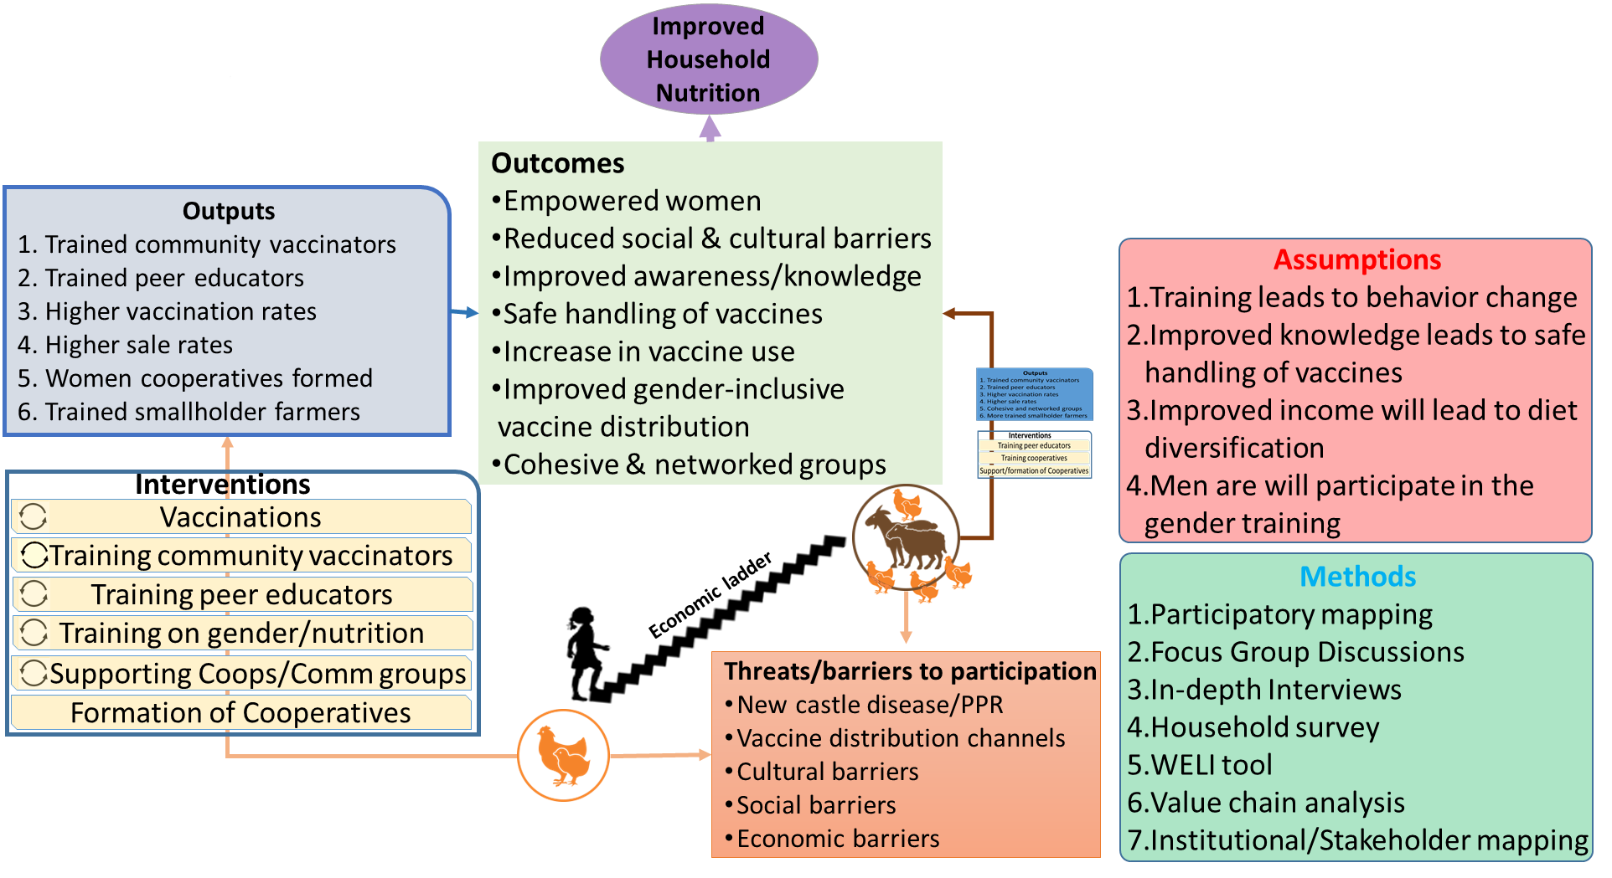
Theory of Change: GIVE PROJECT

Slide 45
Reflections
Improving gender equity in economic and technological inclusion of women and underserved groups in agriculture-oriented services requires several approaches
The issues surrounding the lack of access to and adoption of technology are context-specific and complex. The iceberg analogy
Social norms and behaviour are key for change to take place and for greater equality to be achieved between men and women

Slide 46
Reflections
Gender analysis needed to inform policy, programs and innovations targeting economic and technological inclusion of women and underserved groups in agriculture-oriented services.
2. Understanding of the socio-cultural, economic, political context in which gender power relations occur.
3. Skills and capacity assessment and training for communities especially women targeted with agricultural technologies.
4. Inclusion of Men as enablers of women empowerment in interventions targeted at women

Slide 47

Acknowledgement
This project is supported by the Livestock Vaccine Innovation Fund (LVIF), a partnership of the Bill and Melinda Gates Foundation, Global Affairs Canada, and IDRC.

