Slide 1
Gender transformative research from proposal writing to evaluation
Presenter's Name: Eileen Nchanji, Cosmas Lutomia, and Eveline Compaore
Gender and Social inclusion expert, Alliance of Bioversity International & CIAT/INERA
05 February 2025

Slide 2
Outline
How to integrate Gender equality and social inclusion in proposal writing
  Where are we on the gender agenda
  Frameworks
  Diverse donor expectations
  Tools/guides
  Concrete examples
How to apply Gender transformative approaches – tools and guidelines
  → Where we are
  → Gender transformative approaches – WorldFish/FAO, Gender Impact platform/GTA COP
  Gender transformative indicators
  Some concrete examples
How to develop inclusive gender communication
  What to focus on
  Some concrete examples

Slide 3
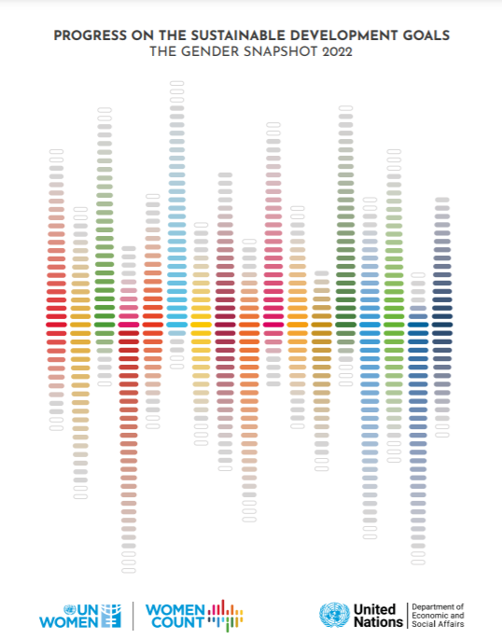
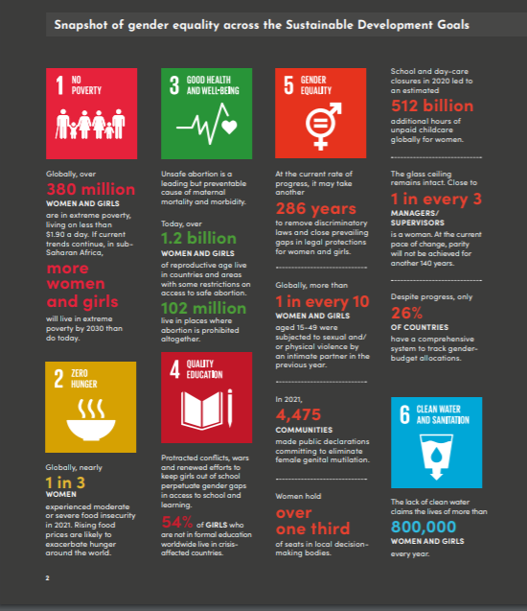
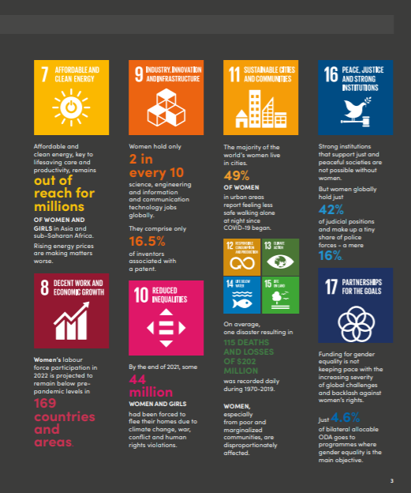
The long road to gender equality…
On current path to progress, 300 years away from gender equality

Slide 4
SDG5: Achieve gender equality and empower all women and girls…
Targets:
5.1 End all forms of discrimination against all women and girls everywhere
5.2 Eliminate all forms of violence against all women and girls in the public and private spheres, including trafficking and sexual and other types of exploitation
5.3 Eliminate all harmful practices, such as child, early and forced marriage and female genital mutilation
5.4 Recognize and value unpaid care and domestic work through the provision of public services, infrastructure and social protection policies and the promotion of shared responsibility within the household and the family as nationally appropriate
5.5 Ensure women’s full and effective participation and equal opportunities for leadership at all levels of decision-making in political, economic and public life
5.6 Ensure universal access to sexual and reproductive health and reproductive rights as agreed in accordance with the Programme of Action of the International Conference on Population and Development and the Beijing Platform for Action and the outcome documents of their review conferences
5.A Undertake reforms to give women equal rights to economic resources, as well as access to ownership and control over land and other forms of property, financial services, inheritance and natural resources, in accordance with national laws
5.B Enhance the use of enabling technology, in particular information and communications technology, to promote the empowerment of women
5.C Adopt and strengthen sound policies and enforceable legislation for the promotion of gender equality and the empowerment of all women and girls at all levels

Slide 5
How to think about and plan for gender equality and social inclusion (GESI) in proposal writing process

Slide 6
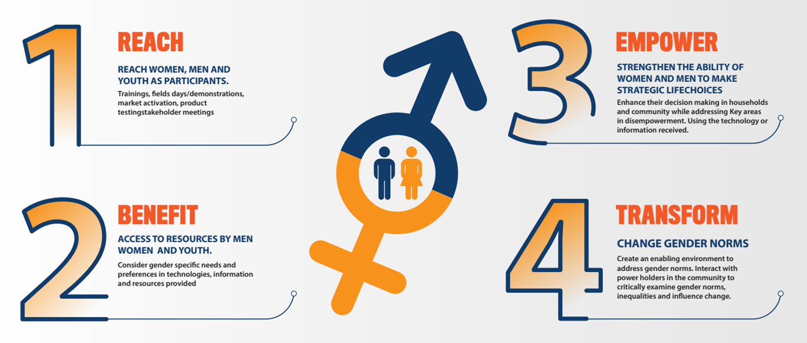
GESI considerations in project design and proposal development
The Reach-Benefit-Empower-Transform (RBET) framework helps researchers align their activities with the level of gender integration aimed at in their projects.
Gender frameworks
Nchanji, E. (2021) Gender frameworks. [Infographic on how to practically integrate gender in your research using the Reach, Benefit, Empower and Transform Framework. ] 1 p. https://hdl.handle.net/10568/113188

Slide 7
GESI considerations in project design and proposal development
Integrating GESI in research proposal and project design requires not only incorporating GESI into activities but also measuring its contribution to addressing gender issues (MEL) and effectively communicating results and lessons learned.

Slide 8
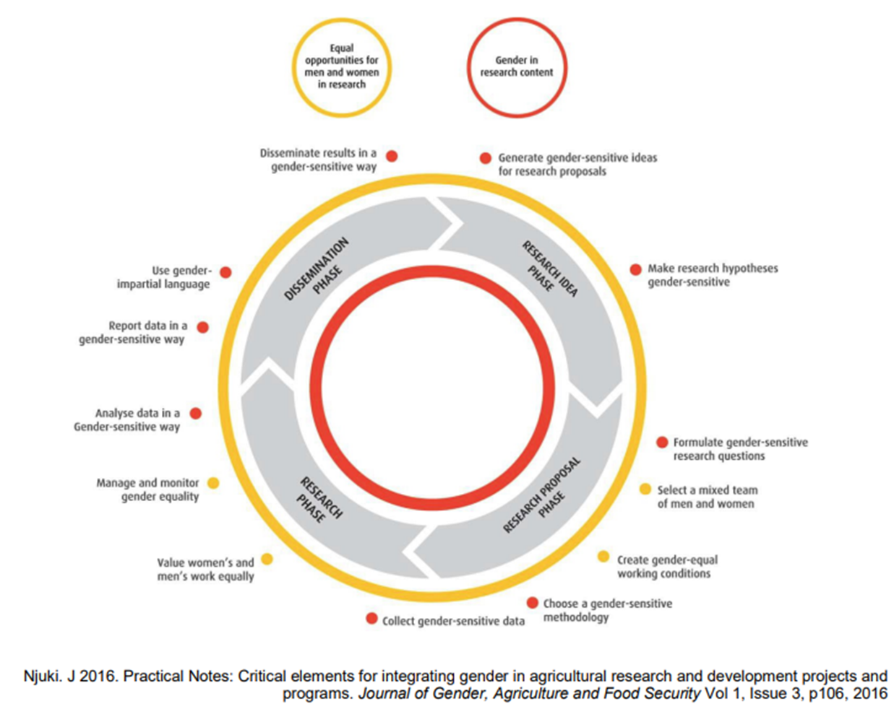
Gender Guideline team composition Proposal writing
Gender expert or advisor
Almost equal number of men and women leading the proposal
Sex of the PI (preferably a woman who is an expert as well)
Beneficiaries – disaggregated by sex and gender – intersectionality should be considered – addressing gender inequality is key, need to have a gender analysis
Stakeholders should be consulted, especially the marginalized
Proposal enhancement support

Slide 9
Gender integration in Proposal writing
Reflect and incorporate gender in the different components below;
Statement of Work
Program Description
Research Objectives
PMF- Project deliverables – activities/outcomes; quantitative and qualitative indicators
Logic Model; monitoring, evaluation, and reporting requirements
Budgets
Design teams must ensure that all gender equality issues are incorporated throughout the proposal rather than in the gender sections
The gender perspective is essential from the beginning to the end and also in every aspect of the project

Slide 10
GESI considerations in project design and proposal development
Funders have varying degrees of expectations when it comes to integrating research projects and design.
Examples of Funders’ gender strategy:
Global Affair Canada (GAC) Gender Coding Scale
Gender in the IKI
Bill& Melinda Gates Foundation (BMGF) Gender Integration Guide
IFAD -Document: (ifad.org)
GIZ - GIZ Gender Strategy. Gender reloaded: Vision needs Attitude – Attitude meets Action
USAID – 2023 Gender Equality and Women's Empowerment Policy | Gender Equality and Women's Empowerment | U.S. Agency for International Development (usaid.gov)
IDRC - Gender equality | IDRC - International Development Research Centre
ACIAR - https://.aciar.gov.au/sites/default/files/2020-08/aciar-gender-guidelines-2020.pdf
Plan UK - 10 top tips for developing gender sensitive/transformative project proposals

Slide 11
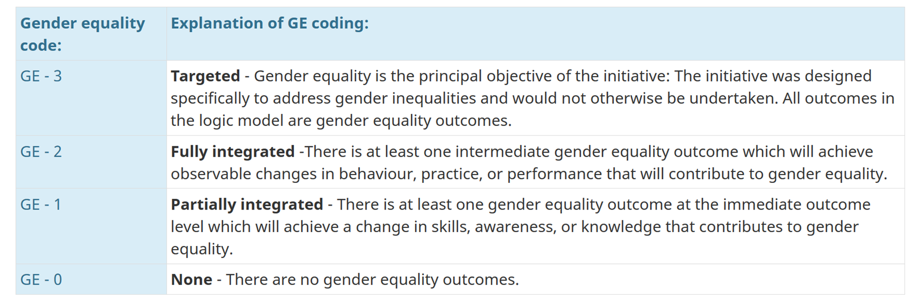
Example of gender scoring card for Global Affairs Canada

Slide 12
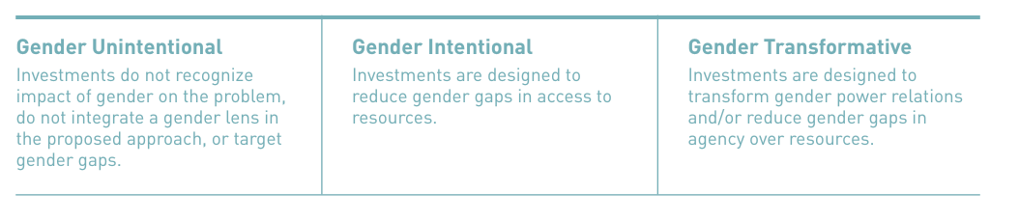
Example of Gender integration guide – Gates Foundation

Slide 13
Examples of proposals where gender has been integrated properly
Beans for Women for Empowerment (Beans4Women) in Eastern DRC
BRAINS: Building Equitable Climate-Resilient African Bean & INsect Sectors

Slide 14
Investable enterprises for climate finance
Improved low carbon, climate resilient economies in the bean and insect corridors of Sub-Saharan Africa
ULTIMATE OUTCOME
Gender-Responsive
(Production & VC)
CSA technology adoption focused (mostly VCs)
Enhanced climate resilience and adaptive capacity among women and youth bean and insect producers
Enhanced adoption of climate-smart agriculture technologies and nature-positive solutions that boost the climate resilience of bean and insect value chains
Enhanced pipeline of investment-ready, carbon-friendly, climate-resilient, and gender-responsive bean and insect-based enterprises for climate finance
INTERMEDIATE OUTCOME
Enhanced business skills, equitable access to resources, and agency for women and youth in bean and insect-based production and value chains
Increased understanding of, and equitable access to, climate-smart agricultural technologies for bean and insect smallholders, MSMEs, and cooperatives
Enhanced access by bean and insect-based smallholders, rural women, and youth entrepreneurs to sources of sustainable finance to fuel uptake of climate adaptation technologies
IMMEDIATE OUTCOME
1. Potential climate finance investors and funds identified, mapped, and linkages brokered with gender-responsive, climate-smart bean and insect enterprise investment projects
1. Critical barriers and entry points that constrain or facilitate the agency of women and youth in bean and insect economies mapped and addressed in strategy
2. {With NARS} New climate-smart bean and insect-based technologies developed and adapted with users
1. Gender-sensitive climate change vulnerability and adaptation (V&A) assessment refined
2. Economic benefits analysis (EBA) identifying value addition and projected economic benefits of specific CSA improvements to bean and insect value chains conducted
2. {Crosscutting} Climate-smart agriculture technologies bundled with social inclusion & gender equity approaches targeting women and youth bean and insect-based producers and enterprises
3. {With NARS, Private Sector} Proven climate-smart bean and insect-based technologies packaged, costed, socialized, and scaled across bean and insect value chains
3. Climate smart, gender-responsive business plans for bean & insect enterprises developed to apply nature-positive technologies to reduce carbon emissions and increase resilience in their operations and/or supply chains
OUTPUTS
3. Business, leadership, and advocacy skills training, mentoring, coaching, and demonstration delivered to women and youth bean and insect value chain actors
5. Digitally-enabled food traceability methodologies and organic certification schemes developed or adapted with women, men, and youth bean and insect producers, enterprises, and food market actors
4. Capacity of bean & insect smallholders, MSMEs, and value chain actors to produce, distribute, and market climate-smart agricultural goods and services enhanced
4. Expanded range of inclusive financial services, CWIS (climate and weather information services) and Index-based insurance tools delivered to bean and insect value chain actors
5. Public-private partnerships platforms established in each hub to sustain commercialization and growth of bean and insect-based enterprises
4. Network of bean and insect corridor equity champions created to advocate for gender equality and empowerment

Slide 15
Different donors - Gender strategy that can act as a guide
GAC - https://www.international.gc.ca/world-monde/funding-financement/gender_equality_toolkit-trousse_outils_egalite_genres.aspx?lang=eng
SDC - https://www.eda.admin.ch/deza/en/home/strategie-21-24/gender.html
FCDO - International Women and Girls Strategy 2023 to 2030 (publishing.service.gov.uk)

Slide 16
Questions and answers – 5mins

Slide 17
How to apply Gender transformative approaches – tools and guidelines

Slide 18
What Does GTA Do To Promote Equality?
Fosters a critical examination of sources of inequalities – root causes - gender dynamics, roles, and norms.
Identifies and strengthens positive norms to create an enabling environment that supports equality.
Enhancing the status of women, girls, and marginalized groups.
Alters social structures, policies, systems, and norms that sustain or validate gender disparities.
→ changing social norms is a daunting task that requires locally-led, constructive, and multifaceted strategies and support from various sectors and stakeholders (FAO, 2024).

Slide 19
Gender Transformative Indicators
When GTAs are designed and implemented, they must be monitored and evaluated.
Gender transformative change indicators should be incorporated into the monitoring and evaluation frameworks - to measure against expected change
What are GTA indicators?
  Are metrics (qualitative and quantitative) used to assess:
  → Participation, roles, leadership, decision-making – agency, and benefits of women and men in various activities, e.g., agriculture.
  In an actively challenging and changing restrictive norms, policies, and power structures.
  Question: experiences from participants:
  Think of an example where a change in policy or practice in agriculture has led to a shift in gender roles in your community. What were the quantitative and qualitative indicators you used?

Slide 20
Designing Comprehensive Gender-Transformative Indicators
Identify the core area(s) of gender equality to be measured - Knowledge, skills and, access to information, agency, power, influence and, decision-making, participation, representation, and leadership (FAO, 2022).
Consider intersectionality in the indicator design process
Recognize insider perspectives when measuring gender transformative change
Develop outcome indicators and identify incremental changes to measure
Strike a balance between qualitative and quantitative indicators
Match research design to overall objectives and available resources
Distinguish between reach, benefit, empower and gender transformative change indicators

Slide 21
What are indicators?
A quantitative or qualitative variable that represents an approximation of the characteristic, phenomenon or change of interest (for instance, efficiency, quality or outcome). Indicators can be used to monitor research or to help assess for instance organizational or research performance.
Qualitative indicators
Measures opinions, attitudes, beliefs, or other traits. These may be less tangible.
Satisfaction
Opinion of a targeted beneficiary (favorable/unfavorable)
Description of a scenario, context, or set of criteria
Quantitative indicators
Measure amounts, usually based in a physical or tangible product or service that can be measured.
# of ….
% of ….

Slide 22
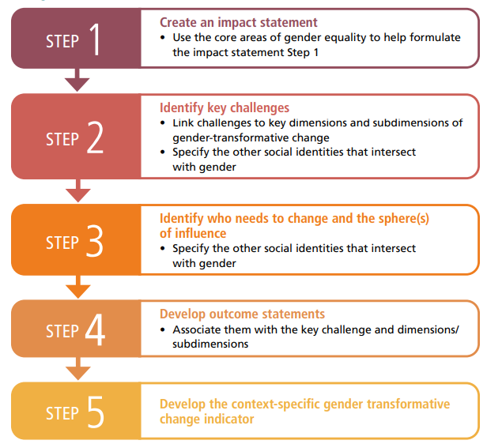
Five-step Process for Developing GT Change indicators
Synthesizing a vision for change based on gender equality goals to set the direction for transformative action.
Strategic focus on systemic barriers to give way for targeted strategies that address the root causes of gender disparities
Identify agents of change and their influence in local context to ensure that the drive towards gender equality is grounded in reality
(FAO, IFAD, WFP & CGIAR GENDER, 2023)

Slide 23
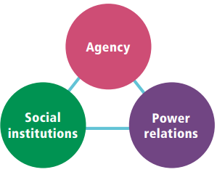
Measuring Progress Towards Gender Equality
Gender transformative change as a process that encompasses a) agency, b) power relations, and c) social institutions (formal and informal)
Spheres of influence where gender transformative change can be measured at a) individual level, b) household level, c)community level, d) organizational level, and e) macro-level
(FAO, IFAD, WFP & CGIAR GENDER, 2023)
(FAO, IFAD, WFP & CGIAR GENDER, 2023)

Slide 24
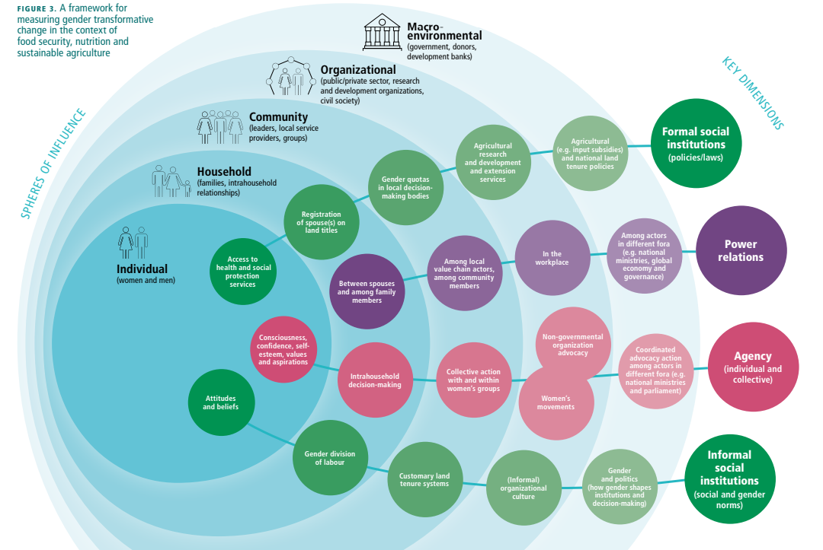
Framework
(FAO, IFAD, WFP & CGIAR GENDER, 2023)

Slide 25
Example Case 1
CARE International’s EKATA (Empowerment through Knowledge and Transformative Action) in Burundi (since 2016) - focused on (CGIAR GENDER PLATFORM, 2021):
Building women’s skills in negotiation, leadership, conflict management, and working together for change.
Challenging norms by bringing men and leaders together to discuss changing norms that lead to inequality and violence.
Challenging discriminatory beliefs and social norms through reflection, community dialogue, and collective action.
Transformation indicators measured:
    →Adoption rates of improved technologies
    →Productivity
    → Dietary diversity for women
    → Income/wealth
    → Women's empowerment
Question: Do we have experiences from the room?

Slide 26
Highlight:
Integrate gender-transformative indicators across all agricultural programs.
Actively involve local communities in developing and implementing agricultural policies and programs.
Establish robust frameworks to assess the effectiveness of gender-transformative strategies continually.
Encourage partnerships between governments, NGOs, and community leaders to amplify the impact of these initiatives.
Is there a need or want for a peer-help group on GTA indicators and monitoring? to assess the effectiveness of gender-transformative strategies continually

Slide 27
Example Case 2
Nepal’s Government Community Animal Health Worker (CAHW) vocational training to individuals in such communities provided:
Access to training and job opportunities to rural women that are of a non-manual nature.
Enable educated rural individuals to work in a less-labour intensive job within their village.
Enable educated rural individuals to support their community in managing livestock
Stepping stone for other work opportunities in agriculture.
Indicators used:
→ Gender attitudes
→ Behavioral orientation of young women in the household

Slide 28
Questions and answers – 5mins

Slide 29
How to develop inclusive gender communication

Slide 30

Inclusive communication should consider:
Equity and representation
Accessibility
Participatory approach
Stereotype-free messaging
Sensitivity and inclusivity

Slide 31
Target audiences and communication approaches
Communication channel | Gender-sensitive approach
Community radio/ | Air gender-focused programs in local languages, ensuring women’s voices are featured.
SMS & mobile platforms | Send financial tips, market updates, and rights-based messages to women’s networks.
Printed materials | Use visual storytelling and infographics for low-literacy audiences.
Social media & digital tools | Leverage WhatsApp, Facebook, and YouTube to engage youth and tech-savvy women.

Slide 32
Target audiences and communication approaches
Communication channel | Gender-sensitive approach
Village meetings & dialogues | Ensure safe spaces for women’s participation and women-only discussion groups.
Manuscripts and journal articles | Publish research to inform academia, development partners, and donors on gender-sensitive interventions and innovations.
Blogs and multimedia case studies | Highlight success stories and disseminate lessons learned on sustainable gender-inclusive agricultural practices.
Reports and policy briefs and dialogues | development partners on gender-sensitive interventions and innovations.
Reports and policy briefs and dialogues | Share research-backed reports and policy briefs with local leadership and policymakers, and donors.

Slide 33
Report writing
Clear purpose - Who are you writing this report for, and why?
A specific audience
Do you understand the directions you are being given regarding this assignment? If not, ask for clarification.
Clarity and conciseness are key
Planning and preparing your report is key
Decide on a clear structure before you begin writing it, and that will make the process much easier
Title of Report - concise heading indicating what exactly you are researching. Your title should be brief, topic-specific, and informative, clearly indicating the purpose and scope of your study. Include key words in your title so that search engines can easily access your work.

Slide 34
Report writing
Table of Contents - list of major sections and headings with page
Executive summary - summary of main findings (optional)
Introduction - what you researched and why
Methodology - what you did and how you did it. It is usually written in a 'passive' voice (e.g. the participants were asked to fill in the questionnaire attached in Appendix 1) rather than an 'active' voice (e.g. I asked the participants to fill in the questionnaire attached in Appendix 1). The purpose of this section is to detail how you conducted your research so that others can understand and replicate your approach. Should be as concise as possible.
Results - what you found. You give the results of your research but do not interpret them.
Discussion - relevance of your results, how it fits with other research in the area.
Conclusion - summary of results/findings

Slide 35
Report writing
Recommendations - what needs to be done as a result of your findings
References - references used in your report or referred to
NB: Use these sci-hub to access restricted journal articles
Appendices - any additional material which will add to your report- Annexes and appendices
  All sources used in your analysis must be acknowledged and referenced throughout your report
  It is vital that you leave adequate time for editing and proofreading. Fresh eyes will catch more errors and omissions than tired ones.
  Proofread your report for spelling, grammar, and punctuation errors, which all create a poor impression and can make the report difficult to read.

Slide 36
Develop guides
Introduction
What is this guide for? –trainers of trainees, other researchers or donors
Who does this guide focus on? – Marginalised and vulnerable groups
How was this guide created? –the method used in generating the data for the guide
Framing the guide using a gender-responsive approach
Example of a guide:
Practical Guide for Mainstreaming Gender in Multi-Stakeholder Platforms in Agri-Food Systems
A Guide for implementing gender-responsive nutrition programs
Guide on the processes and partnerships for co-designing socio-technical innovation bundles for women empowerment and resilience in Ethiopia

Slide 37
Development of PowerPoint
Use the institutional branding
Develop an agenda – introduction, method, result and discussion, conclusion and recommendation
Highlight to emphasize key points.
Incorporate charts, graphs, images, and diagrams to illustrate your points.
Headings, subheadings, and logos should show up in the same spot on each frame. Margins, fonts, font size, and colours should be consistent
Font Style Should be Readable
Don’t Sacrifice Readability for Style

Slide 38
Development of PowerPoint
Italics
Used for “quotes”
Used to highlight thoughts or ideas
Used for book, journal, or magazine titles
Different styles are disconcerting to the audience.
You want the audience to focus on what you present, not the way you present
Colors
Reds and oranges are high-energy but can be difficult to stay focused on. Greens, blues, and browns are mellow but not as attention-grabbing. Reds and Greens can be difficult to see for the colour-blind.

Slide 39
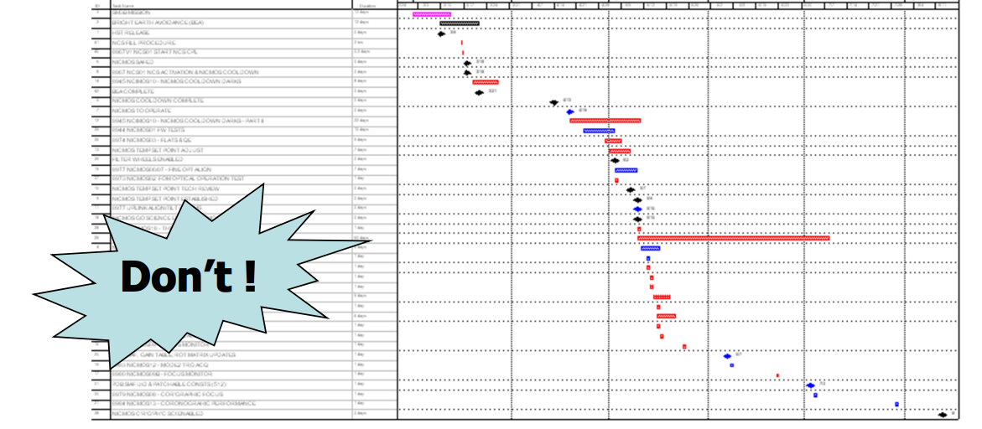
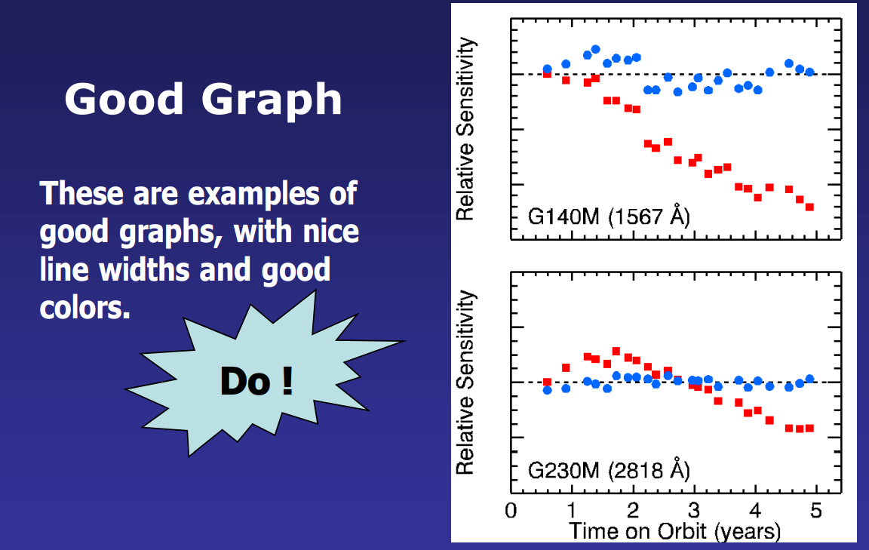
Development of powerpoints
Include notes for each slide to guide you during the presentation. These notes will not be visible to the audience.
Few bullets for key ideas to make information easy to digest – should not be crowded
Use animations but not too much
Same colour across the slides

Slide 40
Develop radio/audio scripts
Define the Purpose and Audience:
Determine the purpose of the audio script (e.g., podcast, advertisement, educational content).
Identify your target audience and their preferences.
Outline the Content:
Create a basic outline of the main points or segments you want to cover.
Include an introduction, main content sections, and a conclusion.
Introduction: Start with a hook to grab the listener's attention. Introduce the topic and any hosts or speakers.
Body: Divide the content into clear, logical sections. Use bullet points for complex information. Include transitions to guide the listener from one point to the next
Conclusion: Summarize the main points. Provide a call to action if applicable (subscribe, leave feedback).

Slide 41
Develop radio/audio scripts
Incorporate Audio Cues:
Add pauses for emphasis or to give the listener time to process information.
Write in a conversational tone to make the script more engaging and avoid jargon and complex sentences.
Read the script out loud to ensure it flows smoothly and sounds natural. Edit for clarity, conciseness, and engagement.
Record a test version to see how it sounds. Make necessary adjustments based on the test recording

Slide 42
Develop radio/audio scripts - Example Audio Script: Women and Land Rights in the Democratic Republic of Congo (DRC)
Host: "Welcome to 'Global Voices,' the podcast where we delve into critical issues affecting communities around the world. I’m your host, Maria Sanchez. In today’s episode, we’re focusing on the vital issue of women and land rights in the Democratic Republic of Congo, or DRC. [Pause] Join us as we explore the unique challenges faced by women in securing land rights, the cultural and legal obstacles, and the efforts being made to empower women and promote gender equality. Stay with us.“
Host: "To understand the issue of women and land rights in the DRC, we need to look at both the historical context and the present-day realities. [Sound effect: distant drum beats] Historically, land tenure systems in the DRC have been deeply influenced by patriarchal norms, where land ownership and inheritance are typically controlled by men. This tradition has left women marginalized when it comes to accessing and owning land.“
[Interview with a local female farmer] “In my village, it’s very difficult for women to own land. Even though we do most of the farming, the land is usually registered in the name of our husbands or male relatives. This makes it hard for us to make decisions or invest in the land we work on.”

Slide 43
Example Audio Script: Women and Land Rights in the Democratic Republic of Congo (DRC)
[Interview with a representative from an NGO] “Our organization collaborates with local communities to promote gender-sensitive land reforms. We conduct workshops, provide legal aid, and work with traditional leaders to change perceptions and practices regarding women’s land rights. It’s a long-term effort, but we are seeing positive changes.”
Host: "Addressing the issue of women and land rights in the DRC requires a multifaceted approach that includes legal reforms, education, and community engagement. By ensuring that women have equal access to land, we can promote gender equality and foster sustainable development. [Pause] Thank you for joining us on 'Global Voices.' We hope this episode has shed light on the critical issue of women and land rights in the DRC. For more information and resources, visit our website at globalvoices.org. Until next time, I’m Maria Sanchez. Stay informed and stay engaged.“
[Outro Music Fades In]
Host: "Don’t forget to subscribe to our podcast and follow us on social media. If you have any questions or topics you’d like us to cover, feel free to reach out. [Music fades out] Goodbye!“

Slide 44
Development of posters
Define Your Purpose and Audience:
Determine the main message or goal of your poster (e.g., event promotion, educational information, advertisement).
Identify your target audience to tailor the content and design accordingly.
Gather Content:
Collect all the necessary information, images, and graphics you want to include.
Make sure the content is relevant and supports the main message.
Choose a Size and Orientation:
Decide on the size of your poster (e.g., A4, A3, A2, etc.).
Choose an orientation that suits your content (portrait or landscape).
Use Design Software:
Use software like Adobe Illustrator, Photoshop, Canva, or PowerPoint to create your poster.

Slide 45

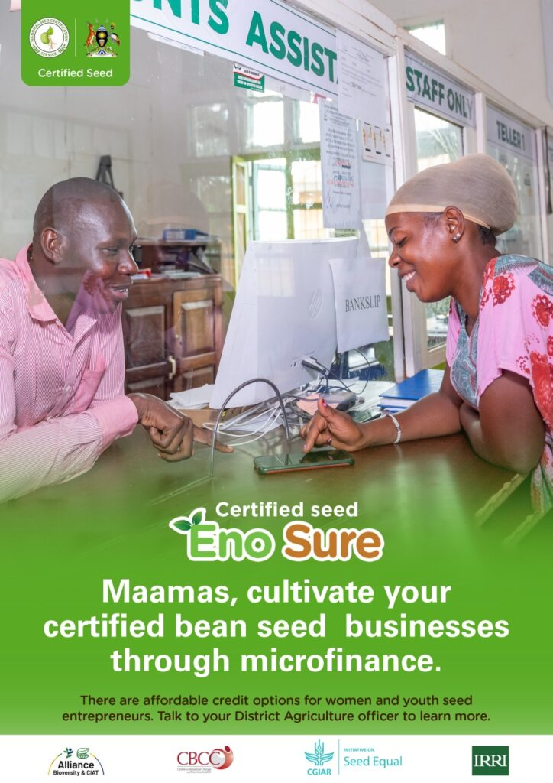
Development of posters

Slide 46
Thanks!
Q&A Session

